Slide 1
Files and Streams
Chapter 17 of Visual C# How to Program, 6/e

Slide 2
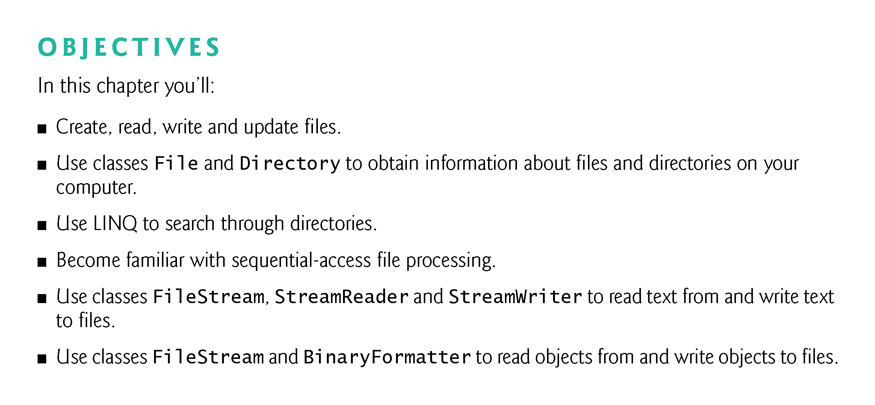

Slide 3
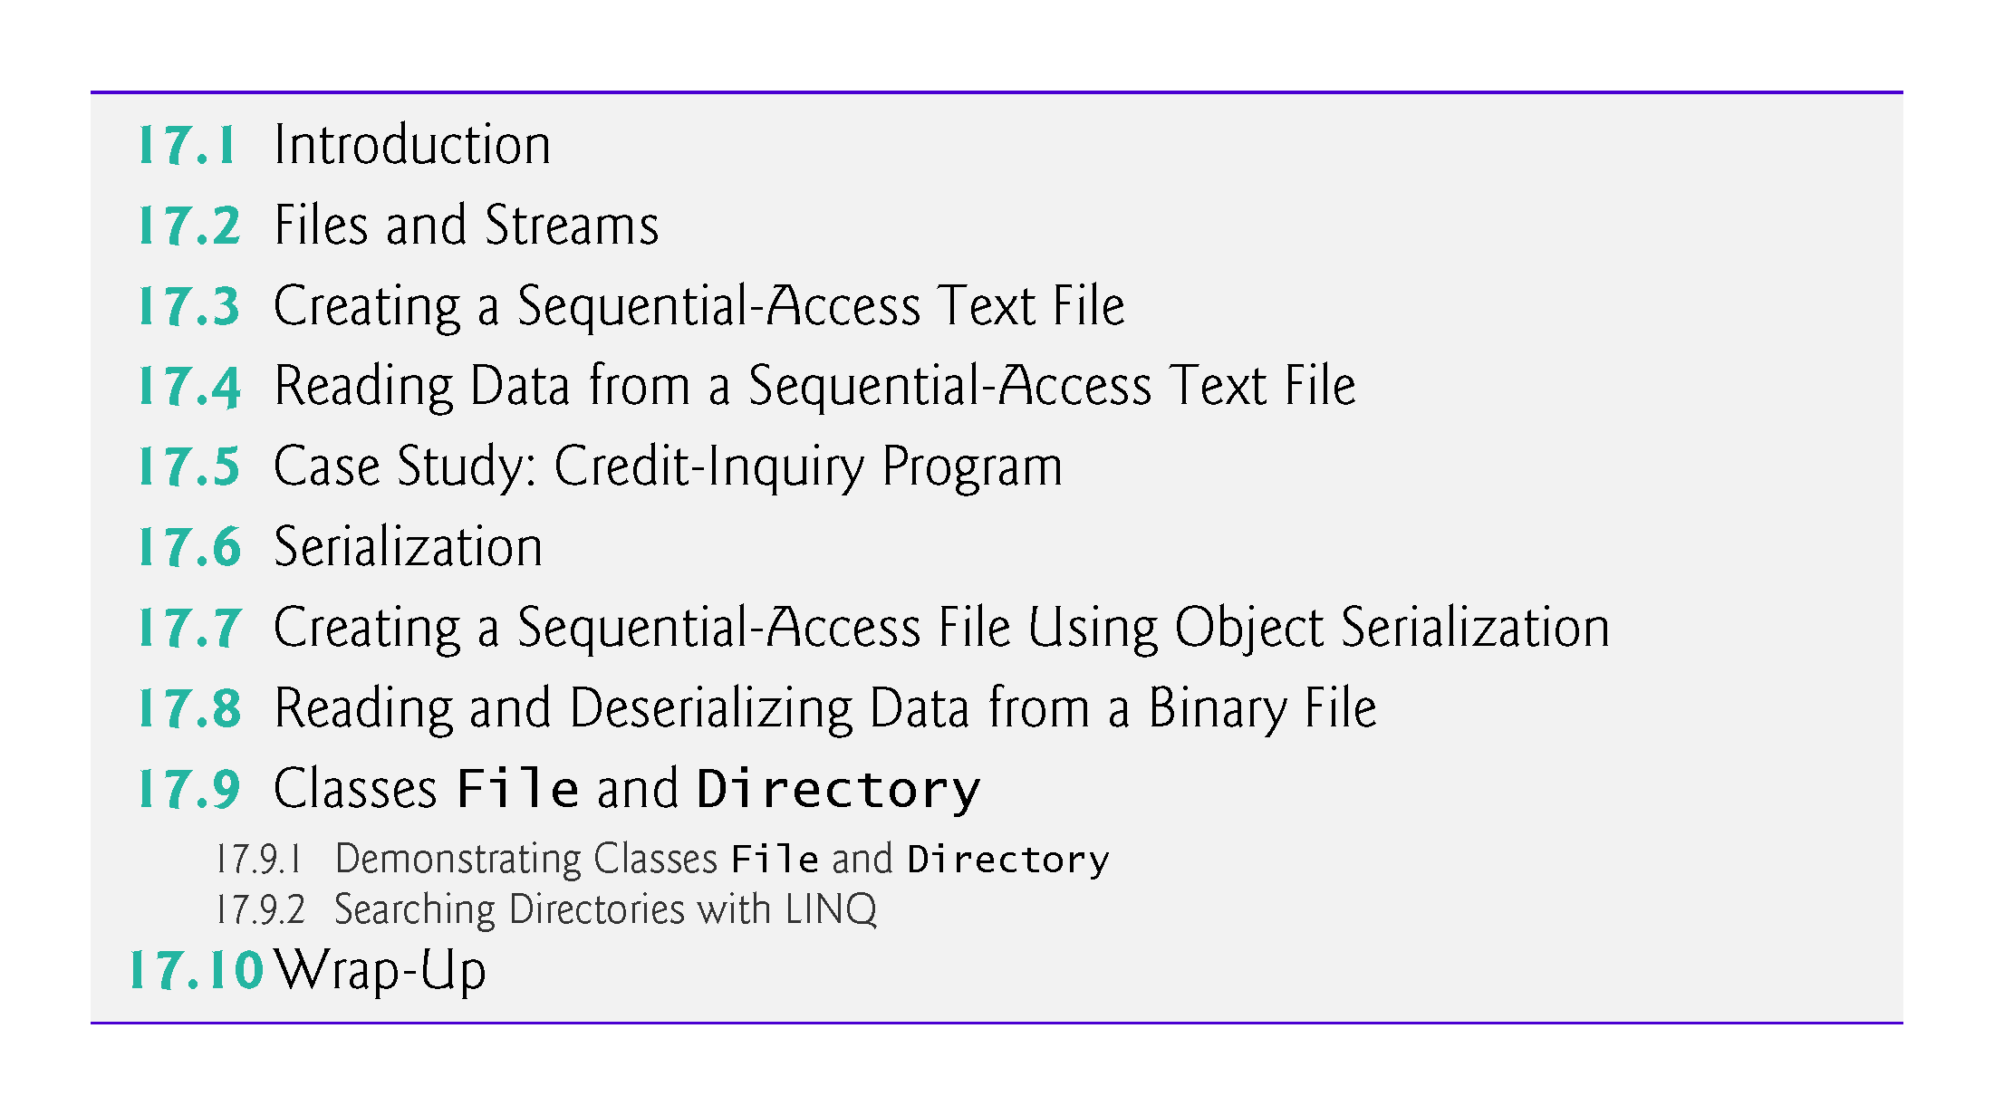

Slide 4
17.1 Introduction
Variables and arrays offer only temporary storage of data（RAM memory）—the data is lost when a local variable “goes out of scope” or when the program terminates.
By contrast, files (and databases, which we cover in Chapter 22) are used for long-term retention of large amounts of data, even after the program that created the data terminates.
Data maintained in files often is called persistent data.
Data maintained in files often is called persistent data. Computers store files on secondary storage devices, such as hard drives, solid-state drives, flash drives, DVDs and tapes
!!!
!!!

Slide 5
17.2 Files and Streams
C# views each file as a sequential stream of bytes (Fig. 17.1).
Each file ends either with an end-of-file marker or at a specific byte number? that’s recorded in a system-maintained administrative data structure.
When a file is opened, an object is created and a stream(buffer) is associated with the object.

Slide 6
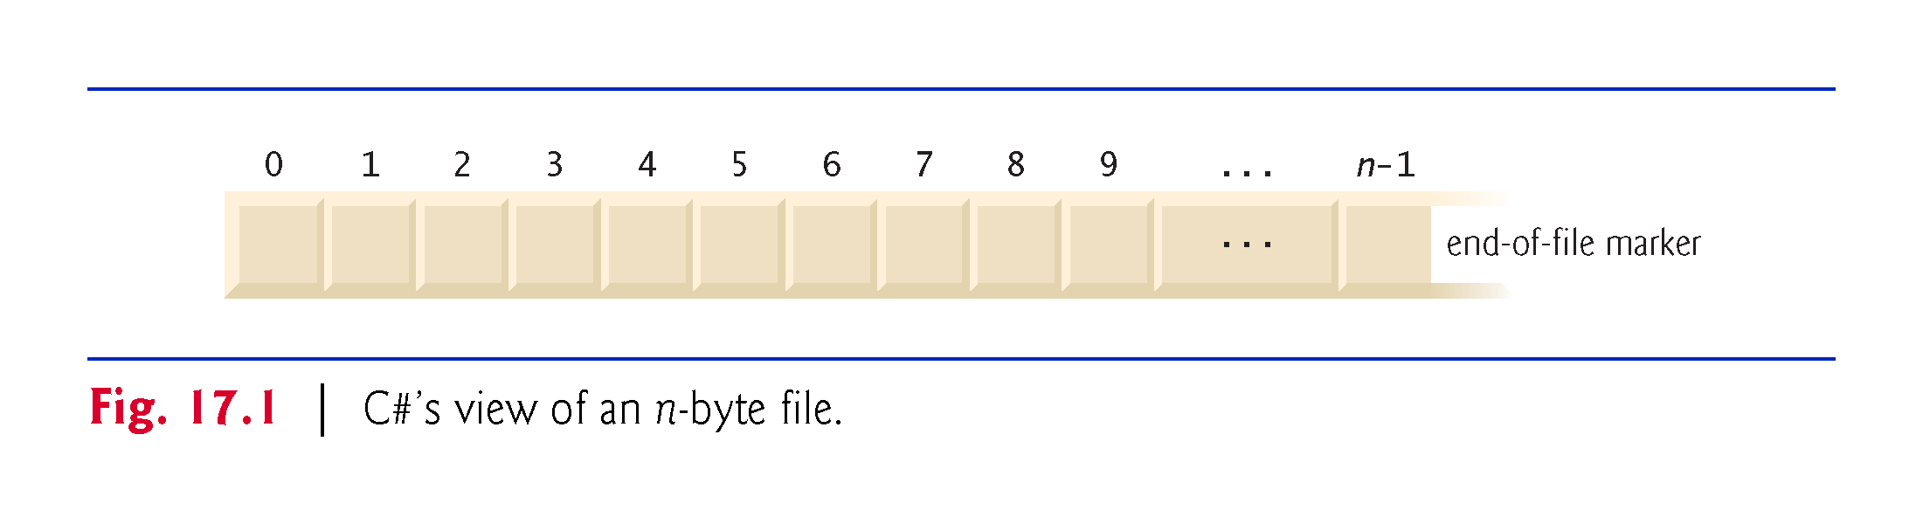

Slide 7
17.2 Files and Streams（buffer） (cont.)
When a console app executes(nothing to do with file), the runtime environment creates three stream objects that are accessible via properties Console.Out, Console.In and Console.Error, respectively.
These objects use streams to facilitate communication between a program and a particular file or device.
Console.In refers to the standard input stream object, which enables a program to input data from the keyboard.
Console.Out refers to the standard output stream object, which enables a program to output data to the screen.
Console.Error refers to the standard error stream object, which enables a program to output error messages to the screen.

Slide 8
17.2 Files and Streams (cont.)
Abstract class Stream provides functionality for representing streams as bytes. Classes FileStream, MemoryStream and BufferedStream (all from namespace System.IO) inherit from class Stream.
Class FileStream can be used to write data to and read data from files.
Class MemoryStream enables the transfer of data directly to and from memory—this is much faster than reading from and writing to external devices.
Class BufferedStream uses buffering to transfer data to or from a stream.

Slide 9
17.2 Files and Streams (cont.)
The System.IO namespace includes stream classes such as StreamReader (for text input from a file), StreamWriter (for text output to a file) and FileStream (for both input from and output to a file).
These stream classes inherit from abstract classes TextReader, TextWriter and Stream, respectively.
Properties Console.In and Console.Out are of type TextReader and TextWriter, respectively.
The system creates objects of TextReader and TextWriter derived classes to initialize Console properties Console.In and Console.Out.

Slide 10
17.3 Creating a Sequential-Access Text File
C# imposes no structure on files.
Thus, the concept of a “record” does not exist in C# files.
This means that you must structure files to meet the requirements of your apps.

Slide 11
17.3 Creating a Sequential-Access Text File (cont.)
Class BankUIForm
The following examples demonstrate file processing in a bank-account maintenance app.
These programs have similar user interfaces, so we created reusable class BankUIForm (Fig. 17.7) to encapsulate a base-class GUI (see the screen capture in Fig. 17.7).

Slide 12
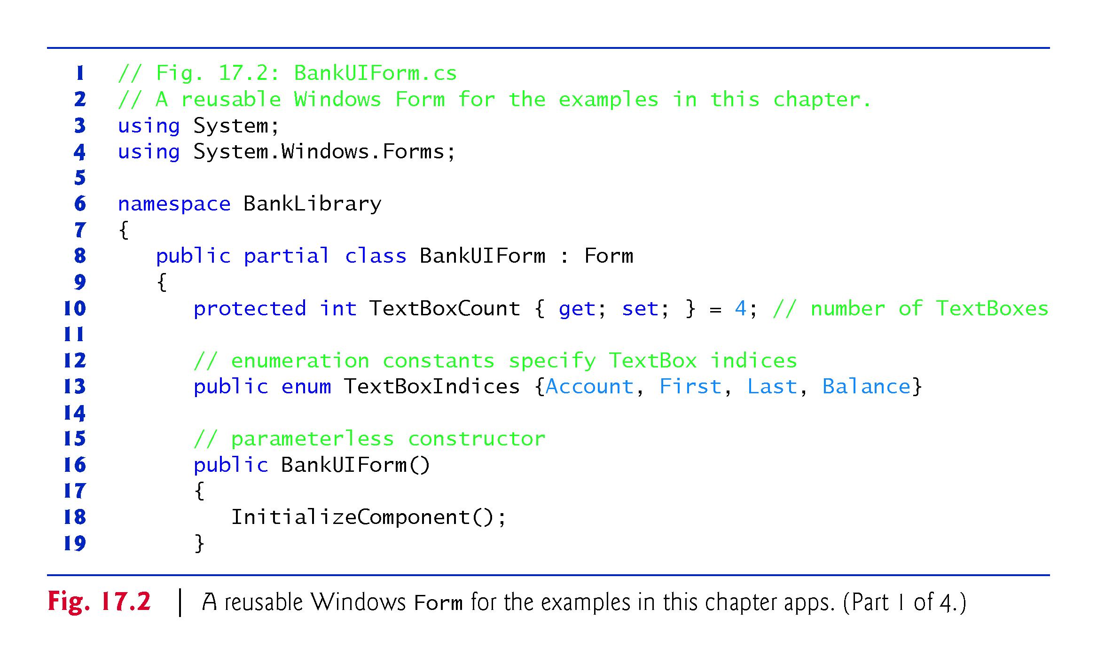

Slide 13
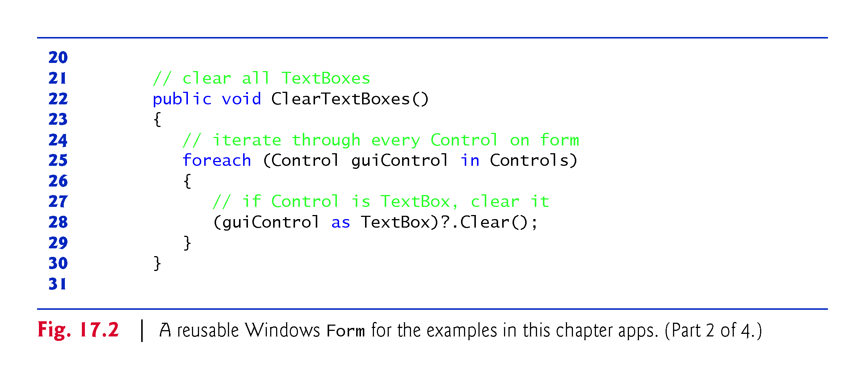

Slide 14
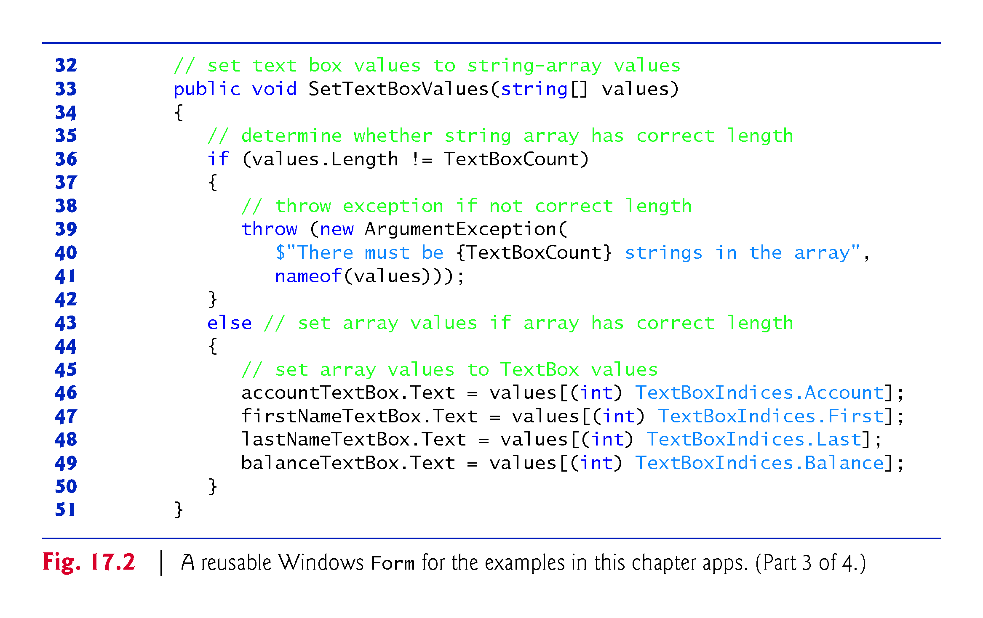

Slide 15
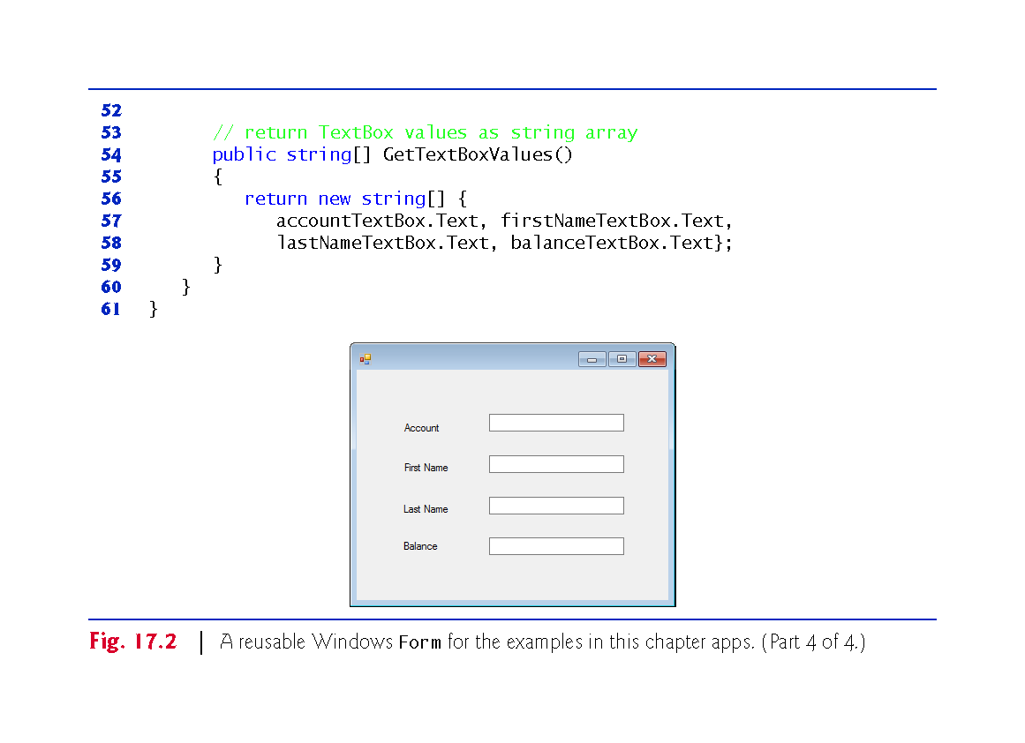

Slide 16
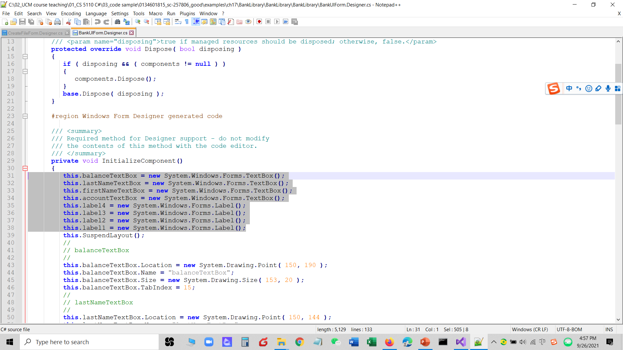

Slide 17
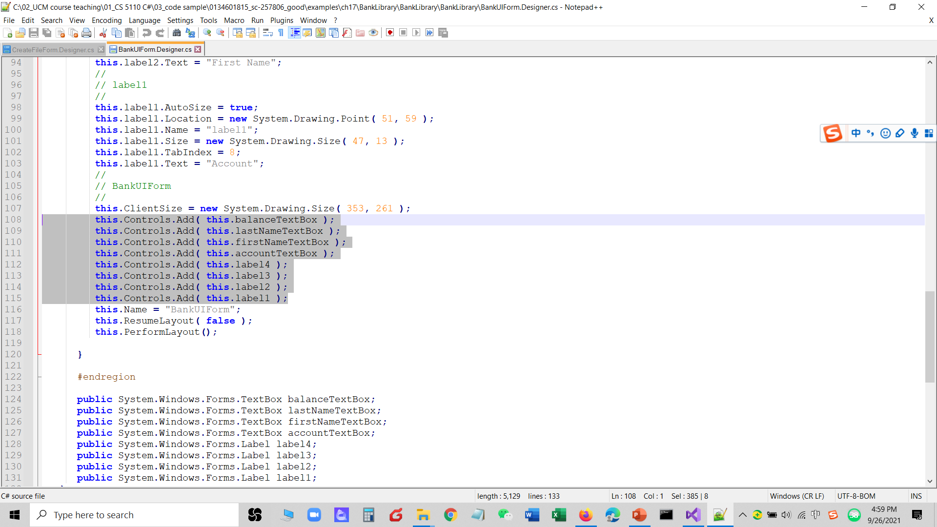

Slide 18
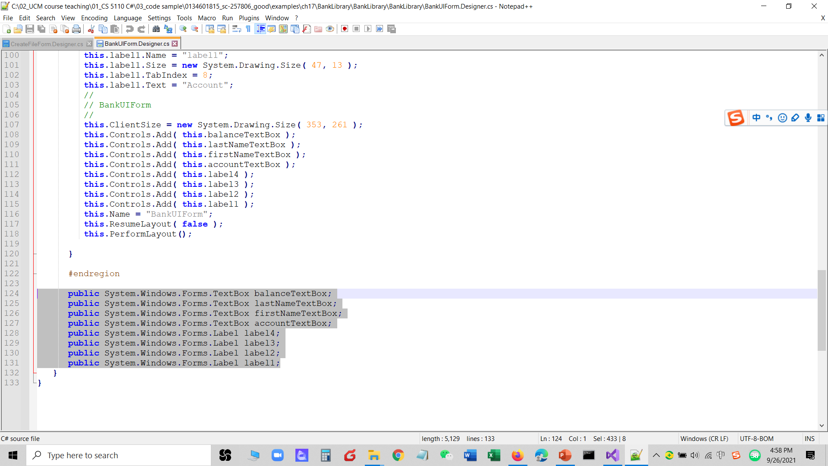

Slide 19
17.3 Creating a Sequential-Access Text File (cont.)
Using visual inheritance (Section 15.13), you can extend this class to create the GUIs for several examples in this chapter.
Recall that to reuse class BankUIForm, you must compile the GUI into a class library, then add a reference to the new class library in each project that will reuse it.
This library (BankLibrary) is provided with the code for this chapter.
You might need to re-add the references to this library in our examples when you copy them to your system, since the library most likely will reside in a different location on your system.

Slide 20
17.3 Creating a Sequential-Access Text File (cont.)
Class Record
Figure 17.8 contains class Record that Figs. 17.4, 17.6 and 17.7 use for maintaining the information in each record that’s written to or read from a file.
This class also belongs to the BankLibrary DLL, so it’s located in the same project as class BankUIForm.

Slide 21
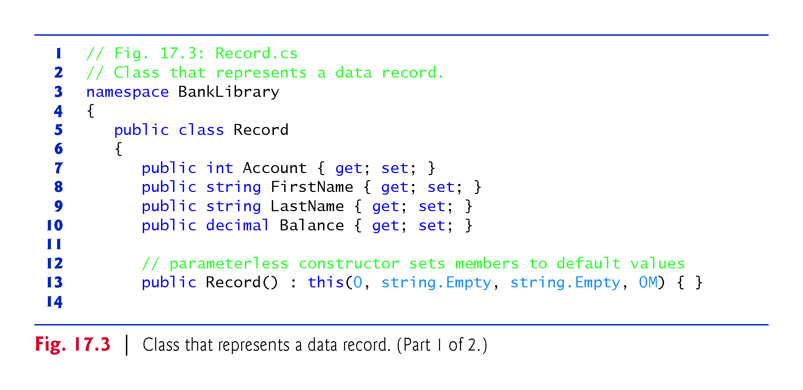

Slide 22
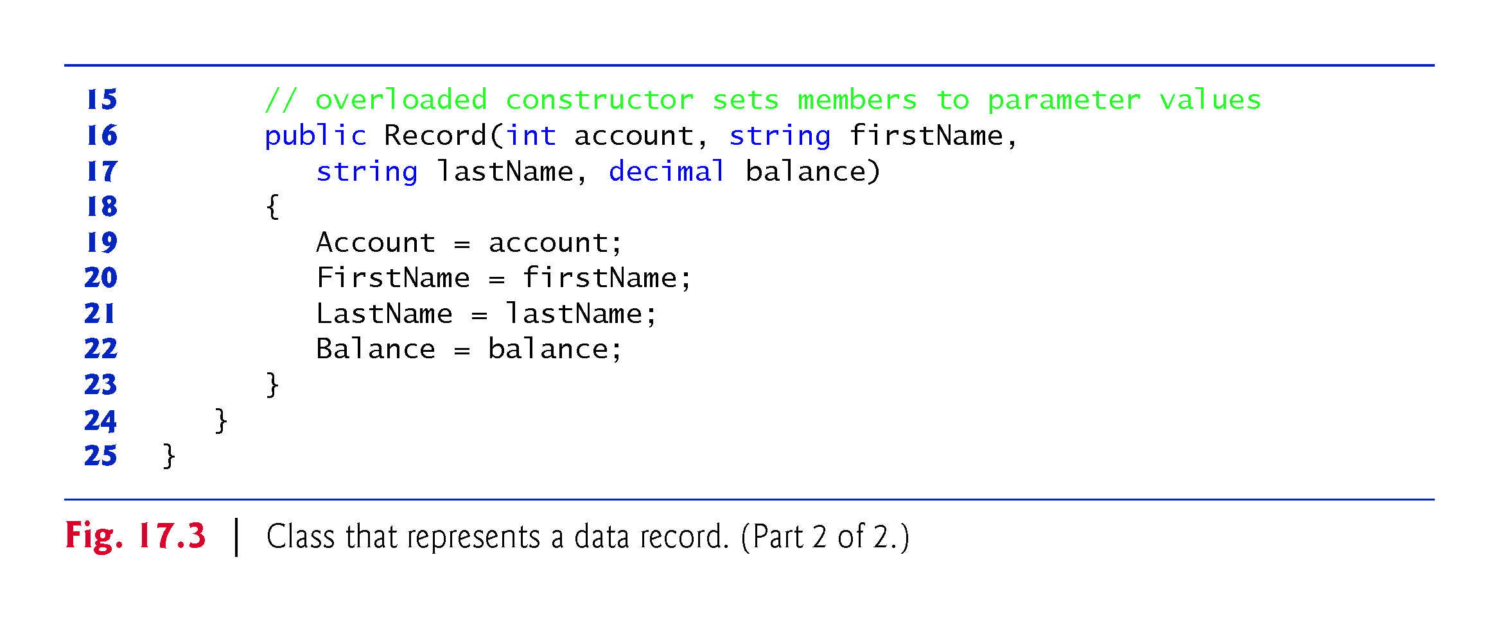

Slide 23
17.3 Creating a Sequential-Access Text File (cont.)
Using a Character Stream to Create an Output File
Class CreateFileForm (Fig. 17.4) uses instances of class Record to create a sequential-access file that might be used in an accounts-receivable system—i.e., a program that organizes data regarding money owed by a company’s credit clients.
For each client, the program obtains an account number and the client’s first name, last name and balance (i.e., the amount of money that the client owes to the company for previously received goods and services).
The data obtained for each client constitutes a record for that client.

Slide 24
17.3 Creating a Sequential-Access Text File (cont.)
In this app, the account number is used as the record key—files are created and maintained in account-number order.
This program assumes that the user enters records in account-number order. However, a comprehensive accounts-receivable system would provide a sorting capability, so the user could enter the records in any order.

Slide 25
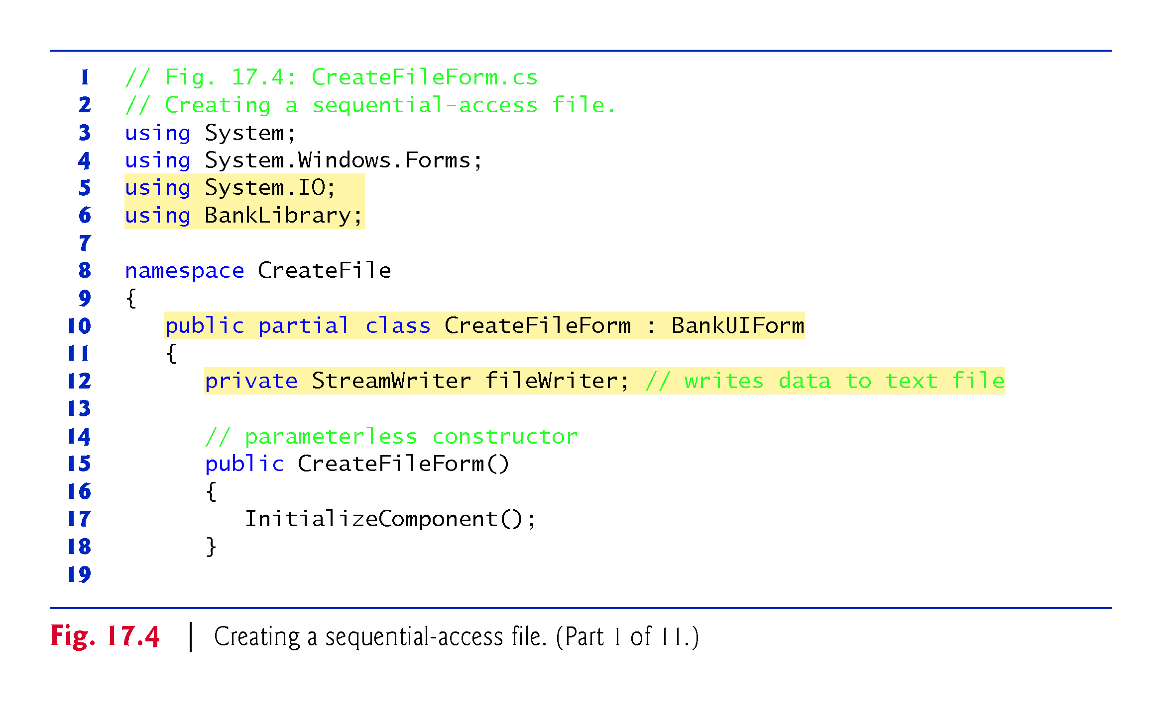

Slide 26
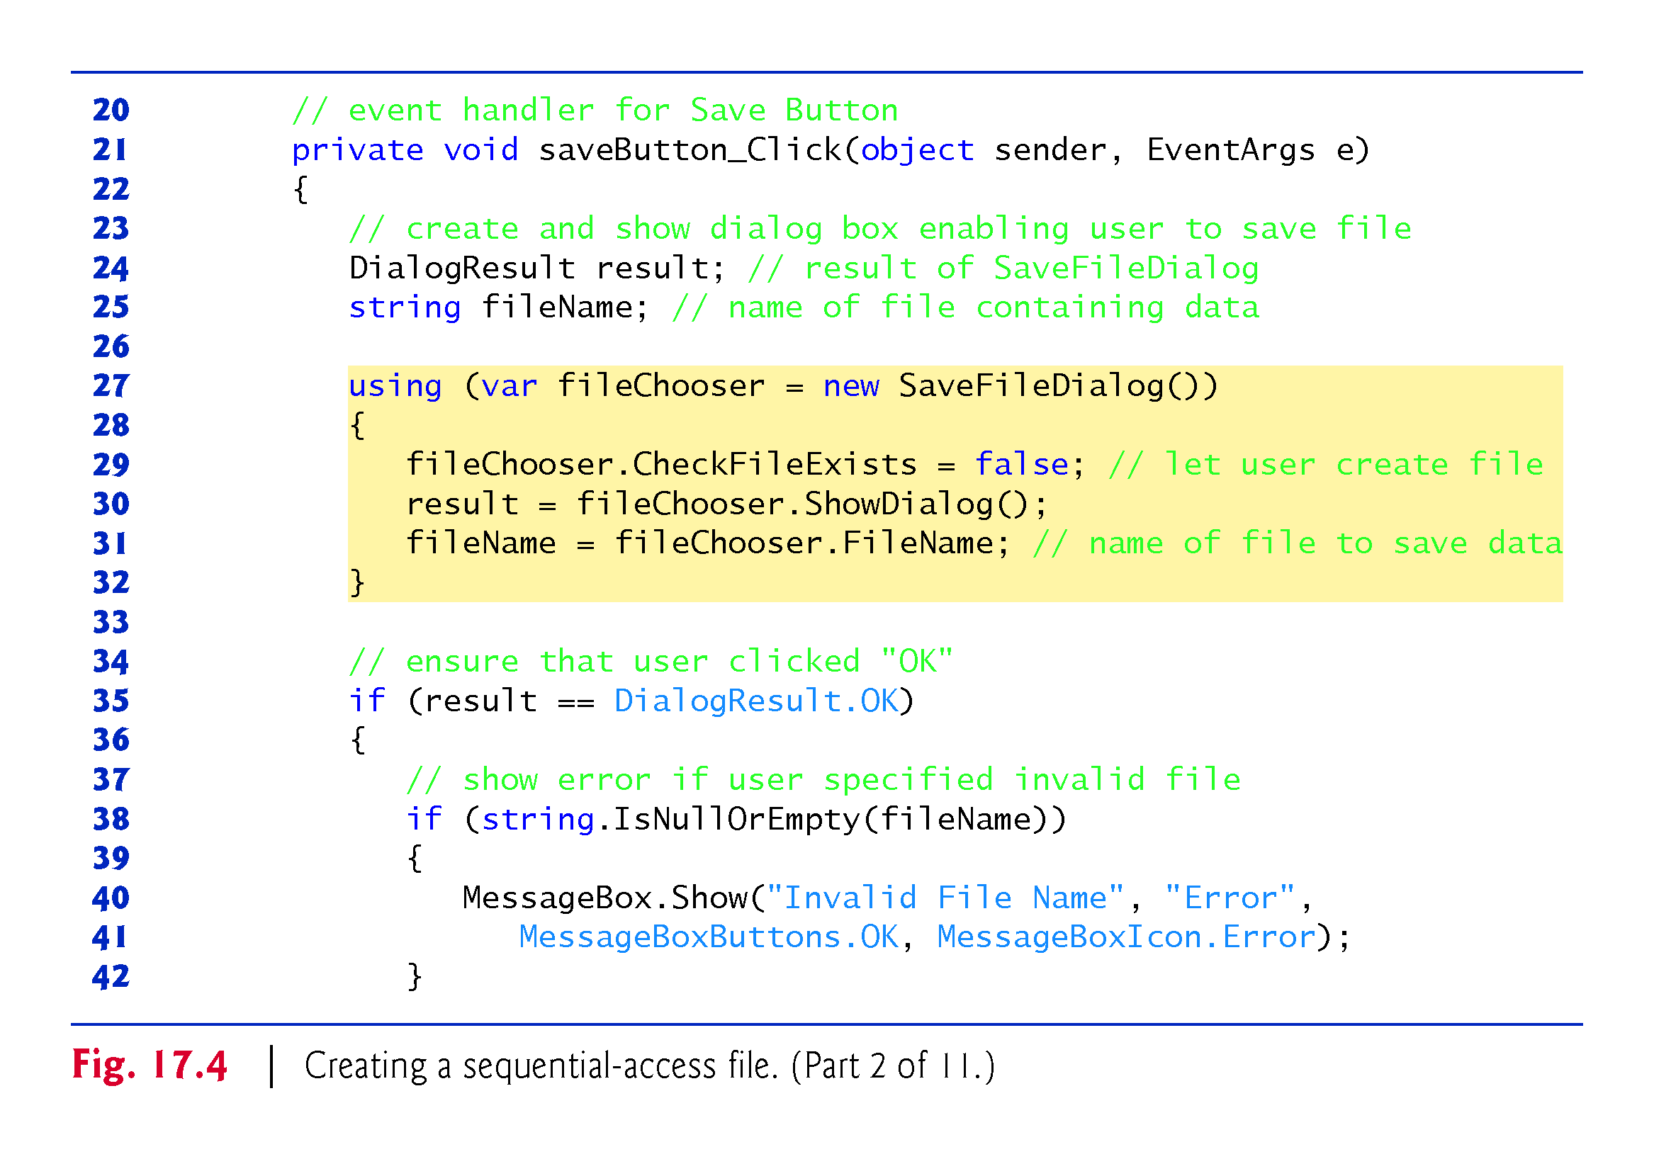

Slide 27
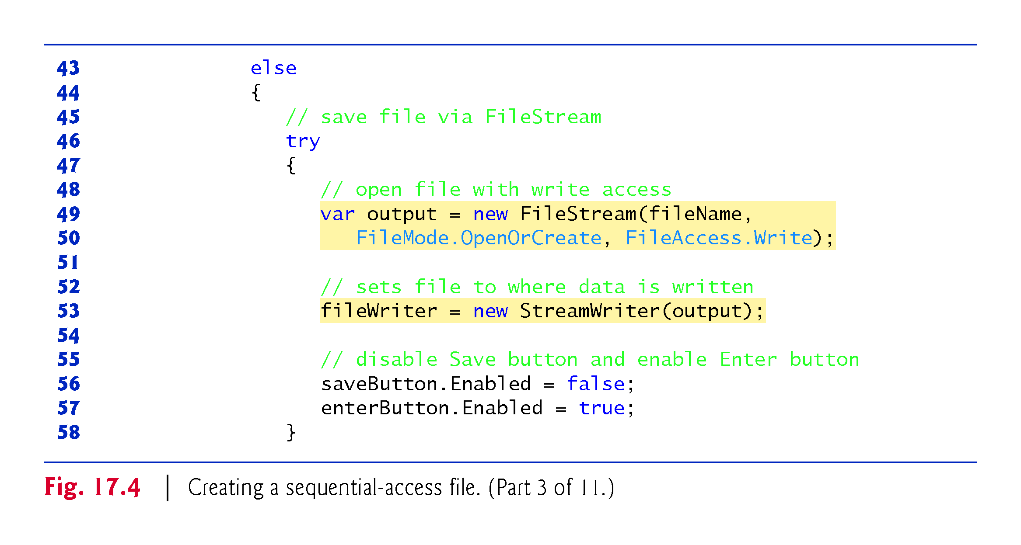

Slide 28
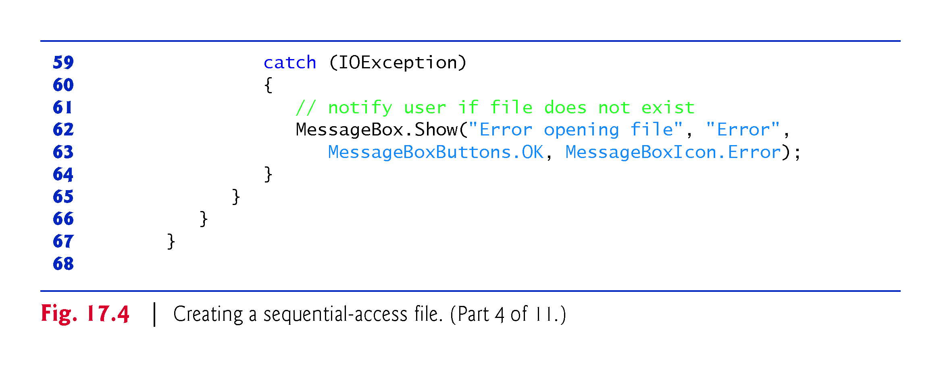

Slide 29
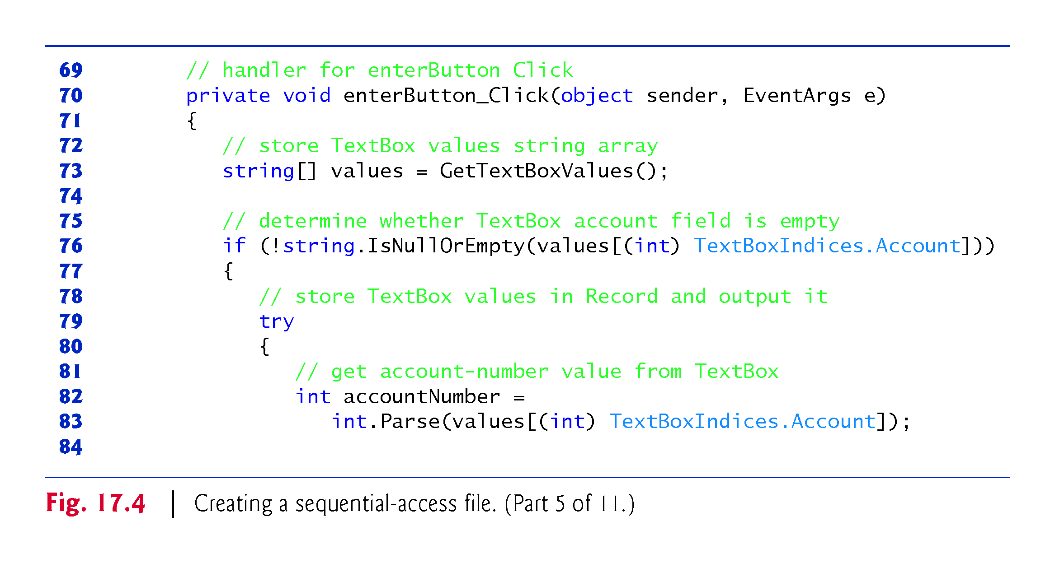

Slide 30
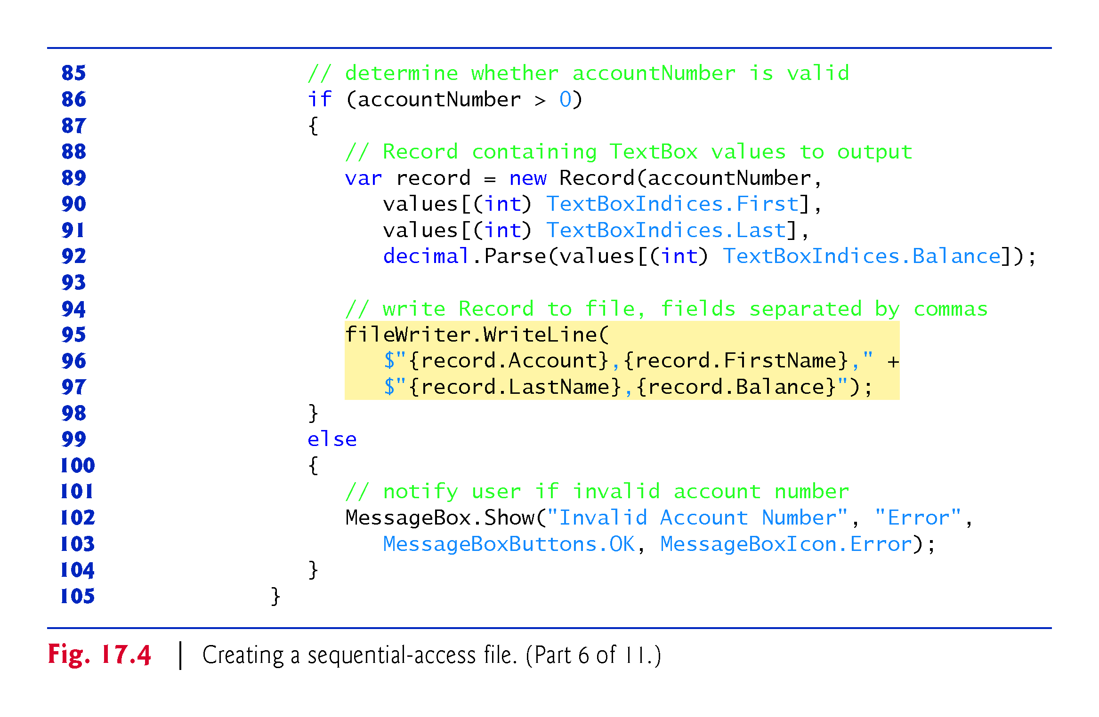

Slide 31
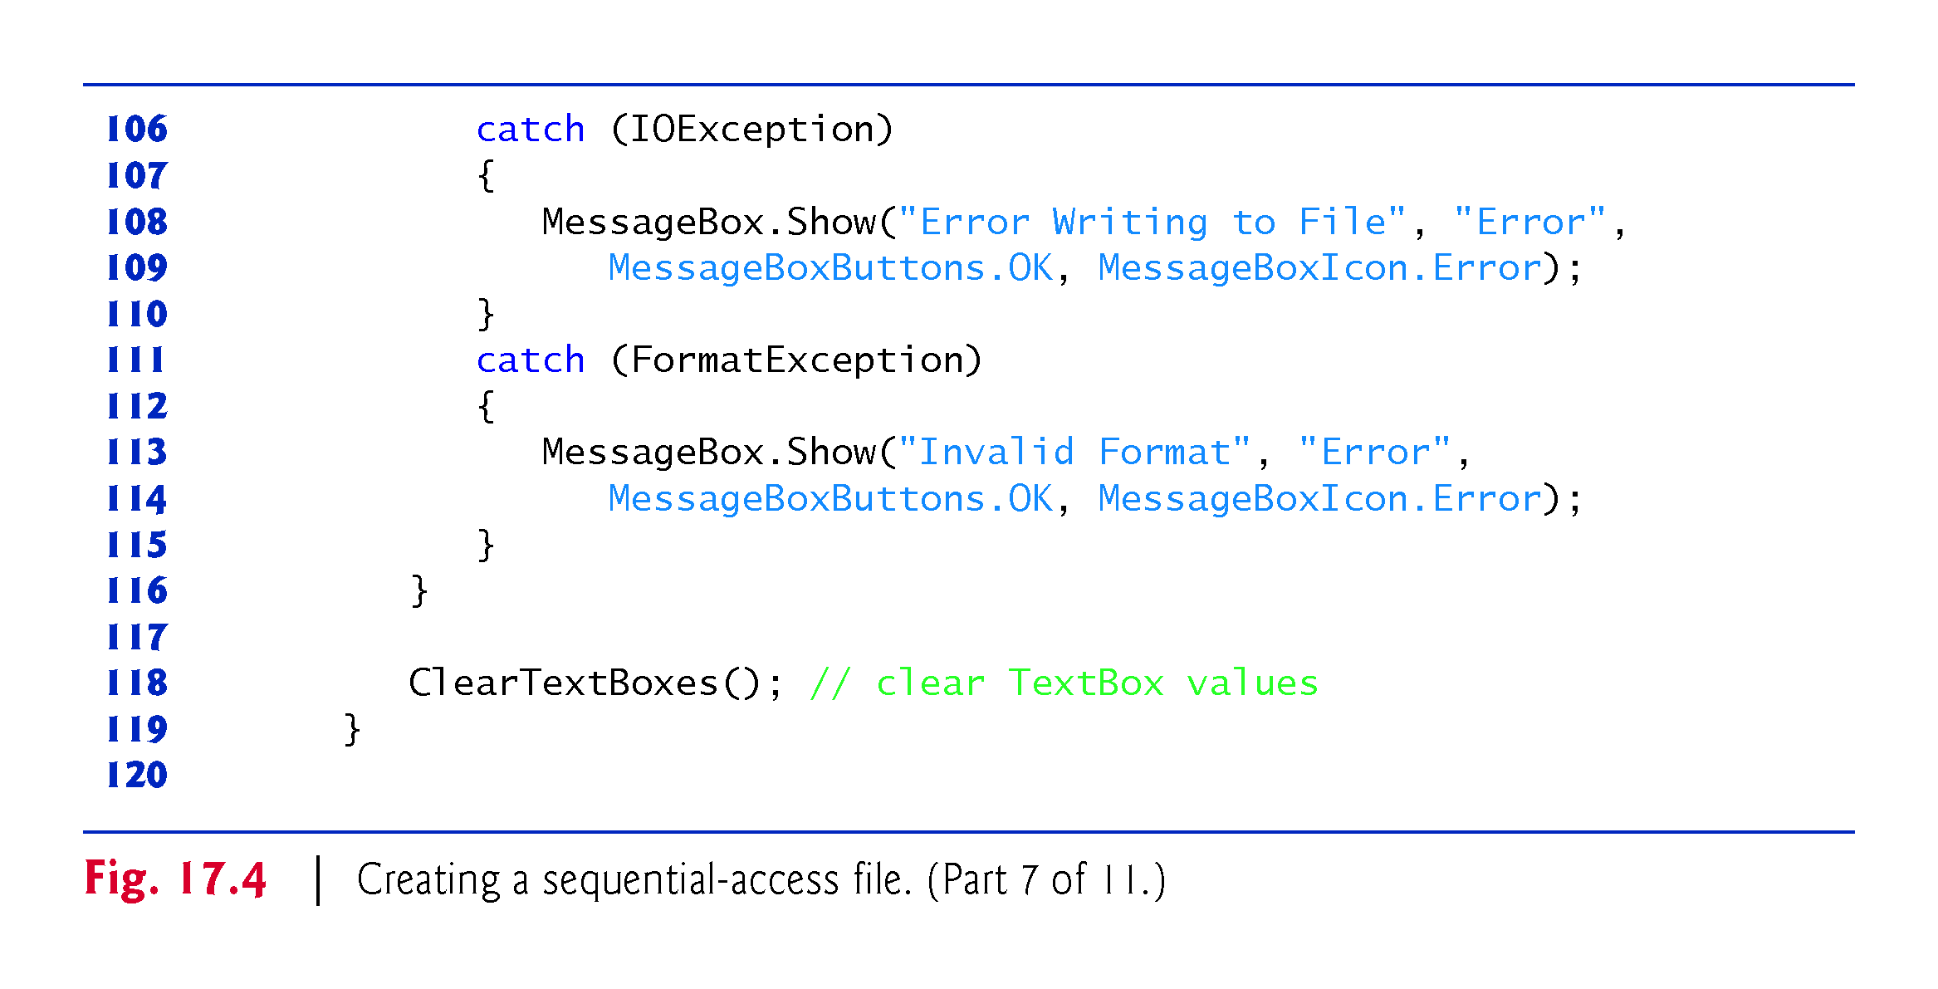

Slide 32
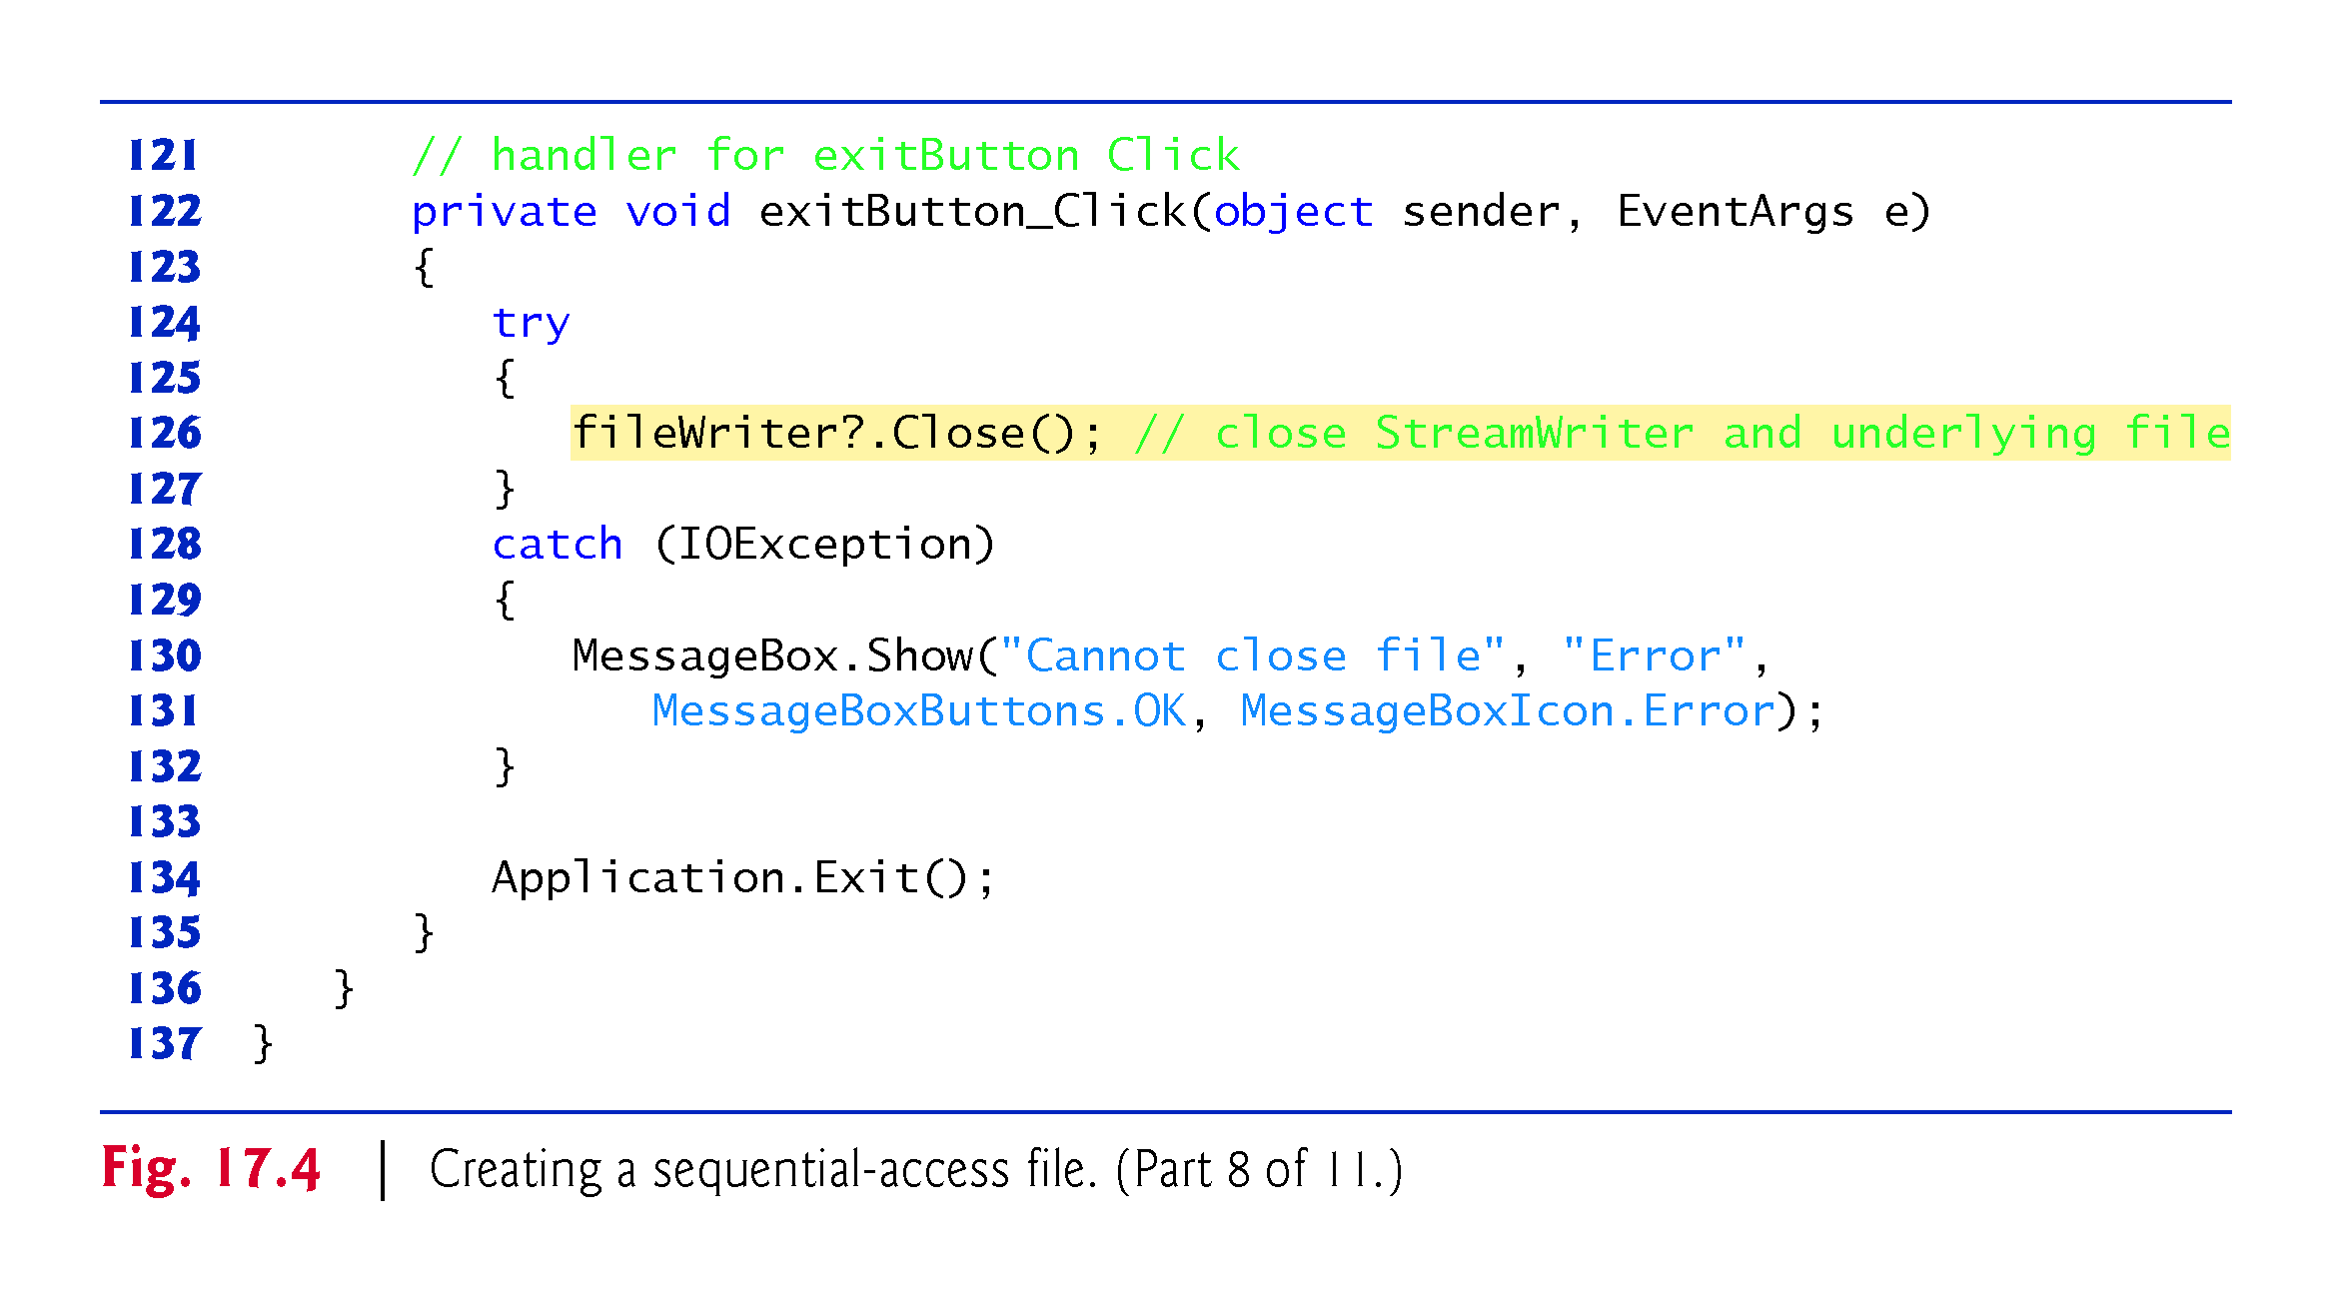
??

Slide 33
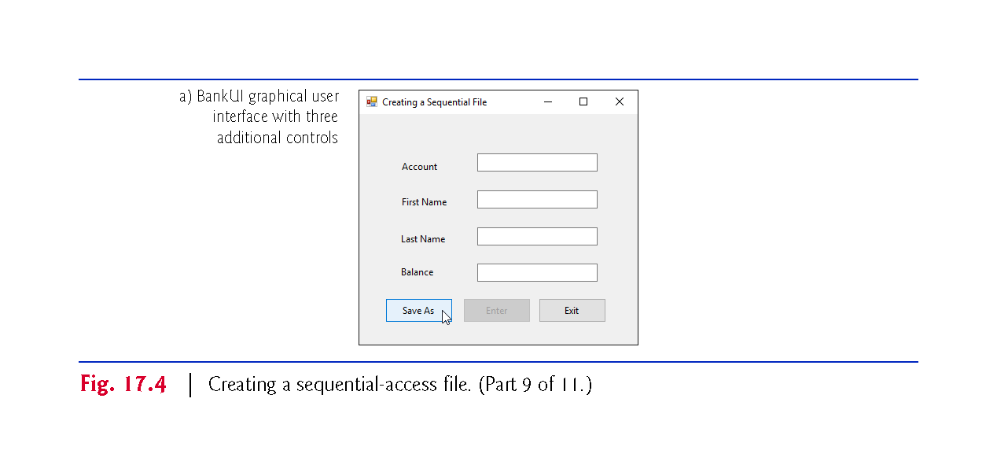

Slide 34
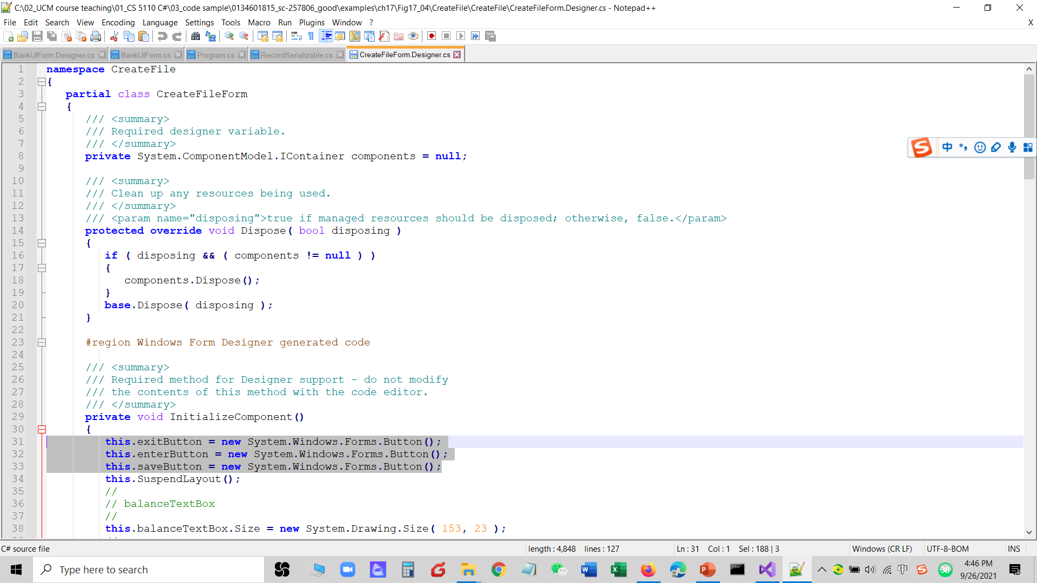

Slide 35
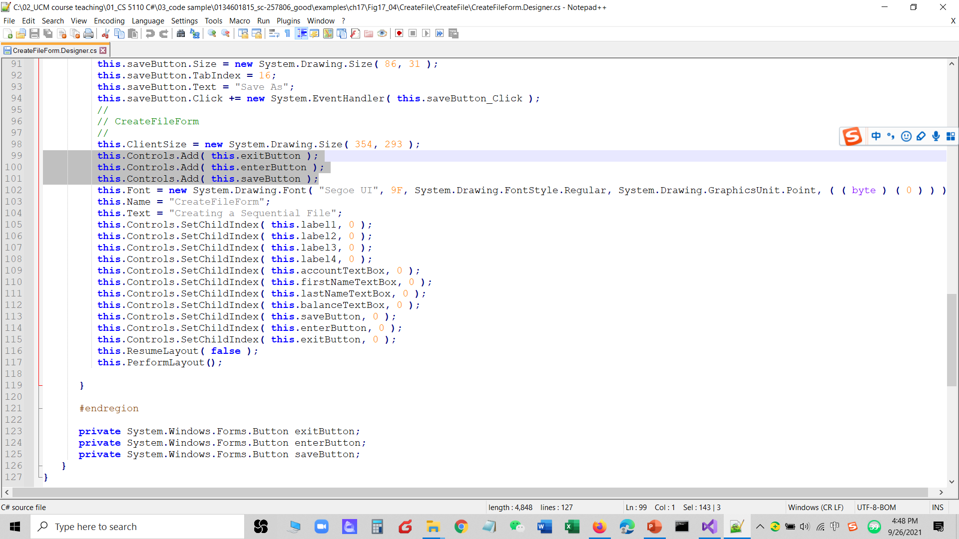

Slide 36
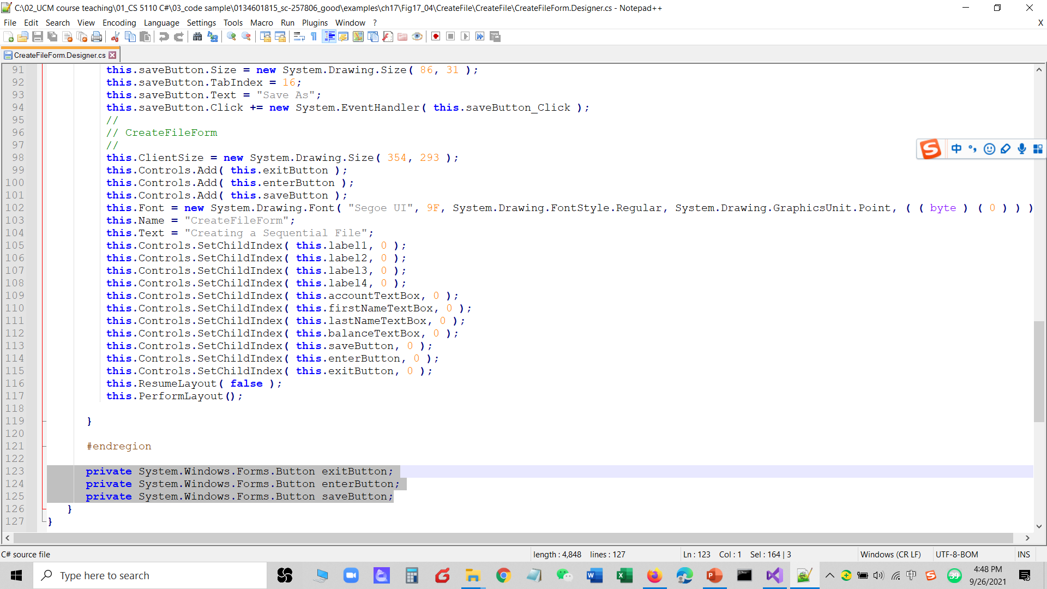

Slide 37
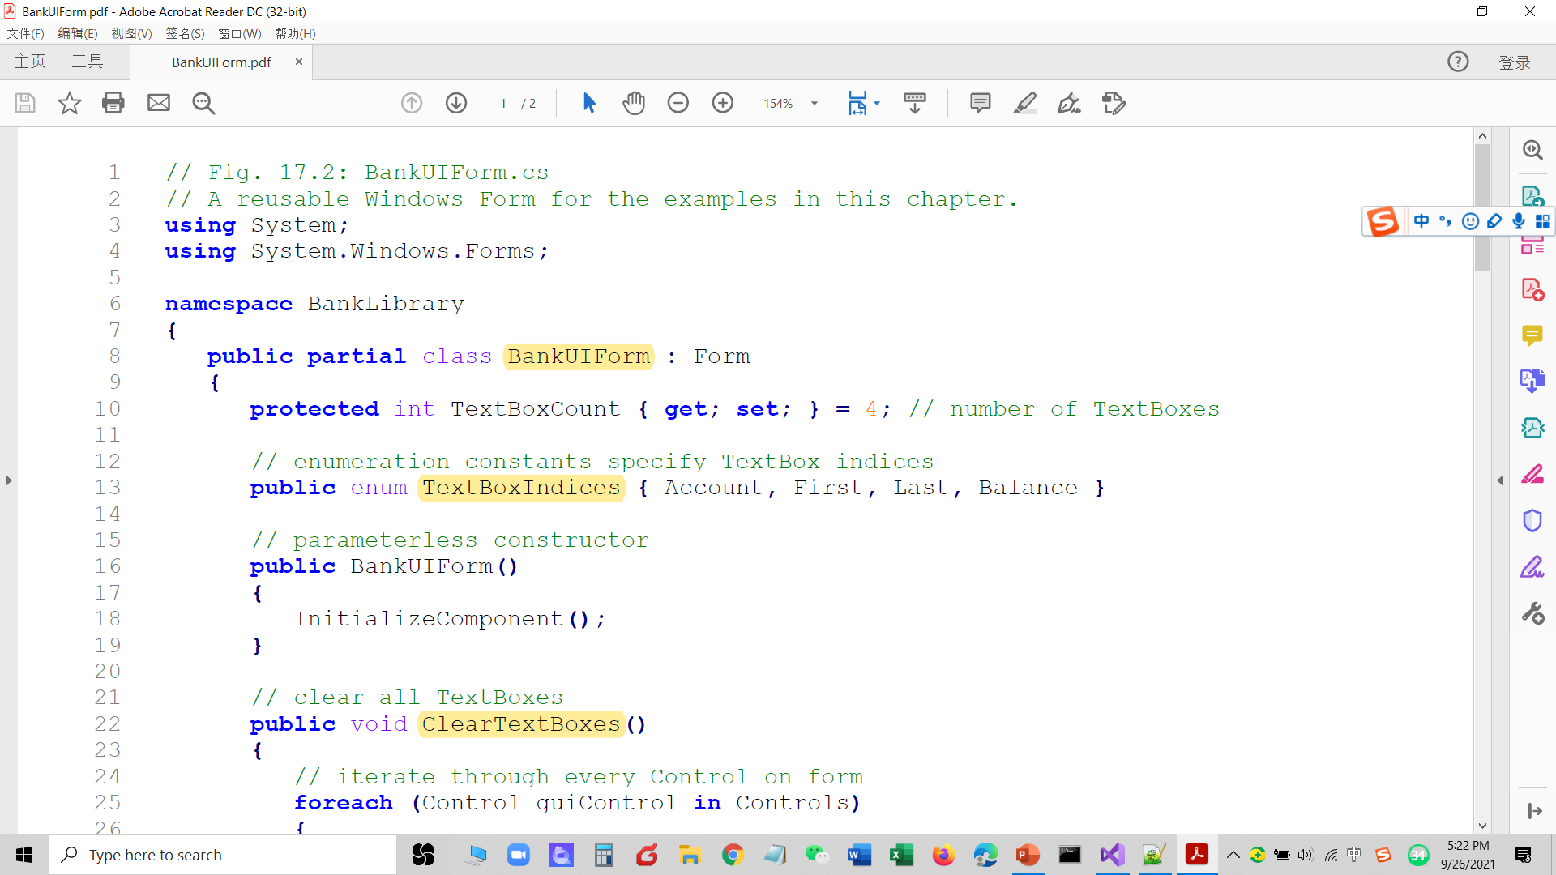

Slide 38
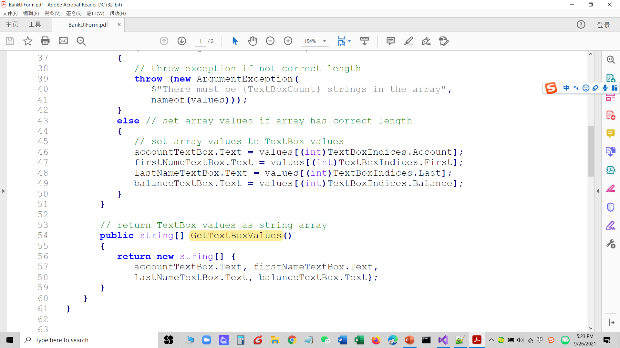

Slide 39
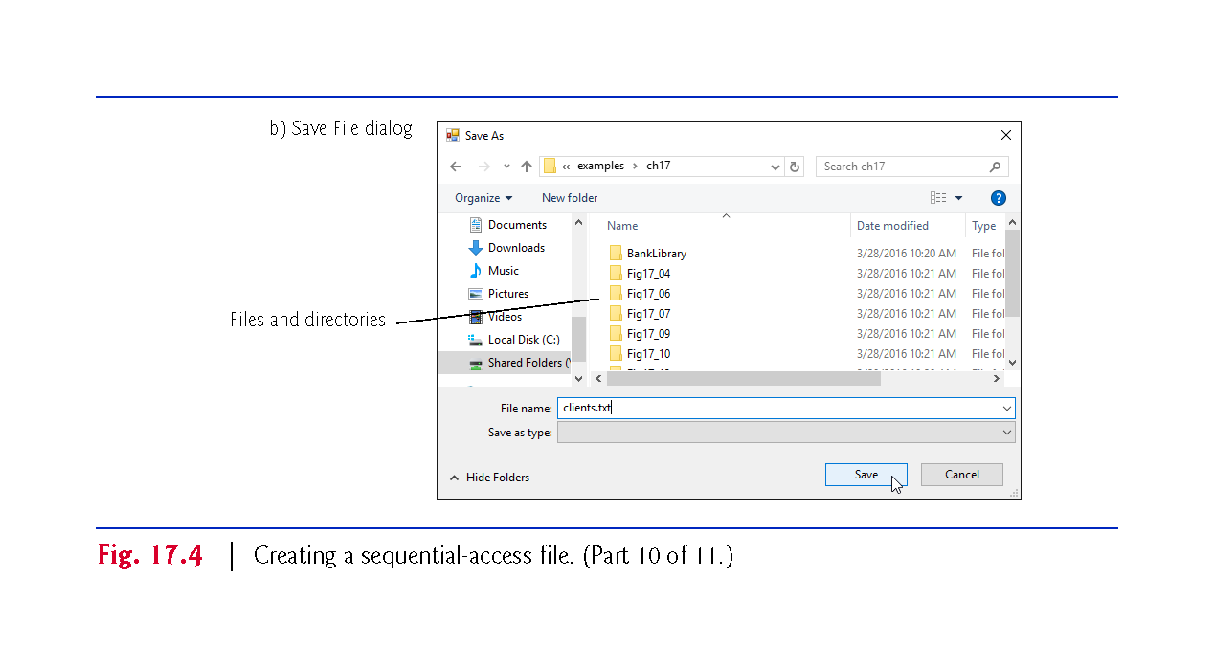

Slide 40
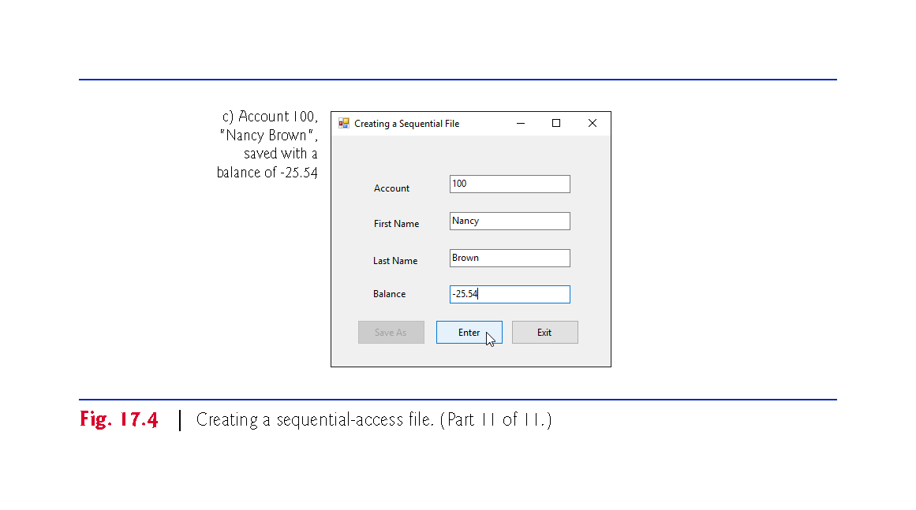

Slide 41
17.3 Creating a Sequential-Access Text File (cont.)
Method saveButton_Click
Line 27 instantiates an object of class SaveFileDialog (namespace System.Windows.Forms).
By placing this object in a using statement (lines 27–32), we can ensure that the dialog’s Dispose method is called to release its resources as soon as the program has retrieved user input from it. SaveFileDialog objects are used for selecting files (see the second screen in Fig. 17.4).
Line 29 indicates that the dialog should not check if the file name specified by the user already exists (this is actually the default).

Slide 42
17.3 Creating a Sequential-Access Text File (cont.)
When displayed, a SaveFileDialog prevents the user from interacting with any other window in the program until the user closes the SaveFileDialog by clicking either Save or Cancel.
Dialogs that behave in this manner are called modal dialogs.
The user selects the appropriate drive, directory and file name, then clicks Save.
Method ShowDialog returns a DialogResult specifying which button (Save or Cancel) the user clicked to close the dialog.
Notes:
modal dialogs

Slide 43
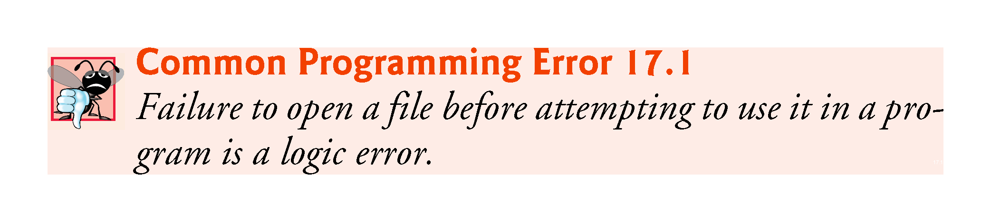

Slide 44
17.3 Creating a Sequential-Access Text File (cont.)
Method enterButton_Click
After typing information into each TextBox, the user clicks Enter, which calls enterButton_Click (lines 70–119) to save the data from the TextBoxes into the user-specified file.
If the user entered a valid account number, lines 89–92 create a Record containing the TextBox values.
If the user entered invalid data, the program throws a FormatException.
Lines 95–97 write the record to the file by invoking method WriteLine of the StreamWriter object that was created at line 53.

Slide 45
17.3 Creating a Sequential-Access Text File (cont.)
Method exitButton_Click
When the user clicks Exit, exitButton_Click (lines 122–135) executes.
Line 126 closes the StreamWriter, which automatically closes the FileStream.
Then, line 134 terminates the program.
Note that method Close is called in a try block.
Method Close throws an IOException if the file or stream cannot be closed properly.
In this case, it’s important to notify the user that the information in the file or stream might be corrupted.

Slide 46
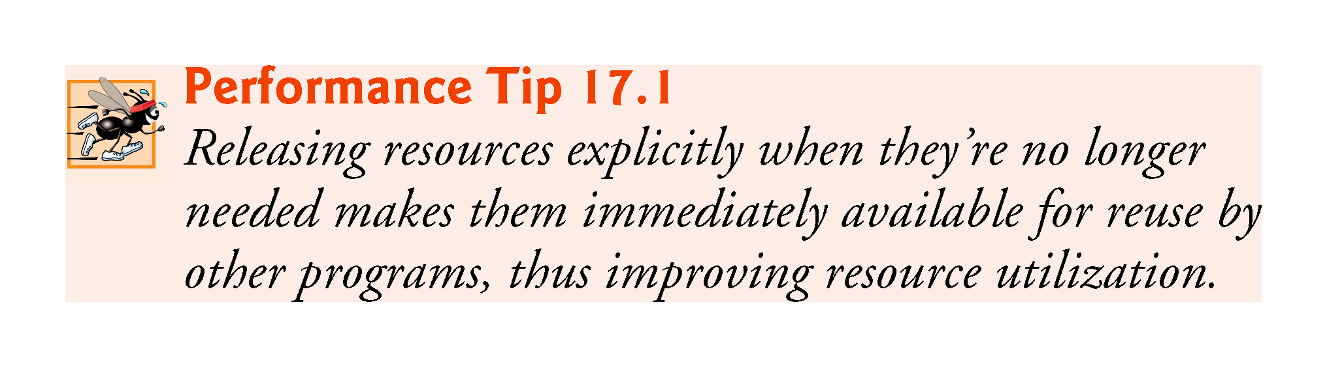

Slide 47
17.3 Creating a Sequential-Access Text File (cont.)
Sample Data
To test the program, we entered information for the accounts shown in Fig. 17.5.
The program does not depict how the data records are stored in the file.
To verify that the file has been created successfully, we create a program in the next section to read and display the file.
Since this is a text file, you can actually open it in any text editor to see its contents.

Slide 48
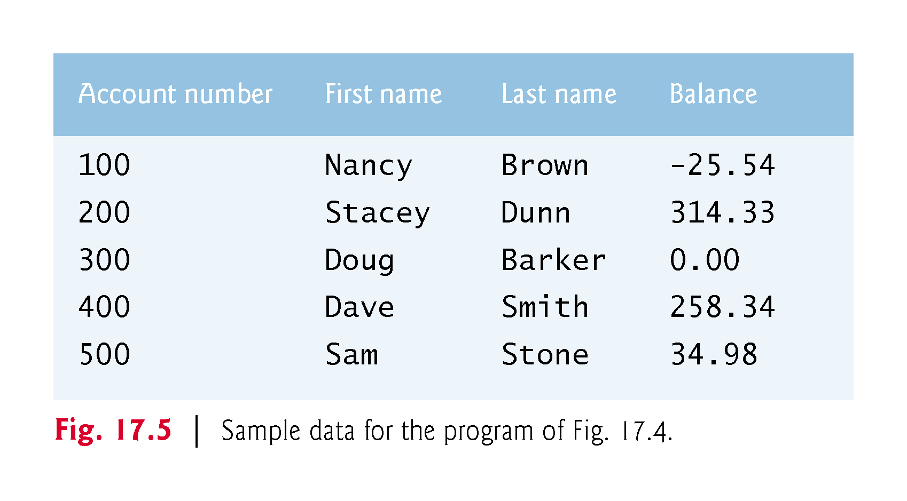

Slide 49
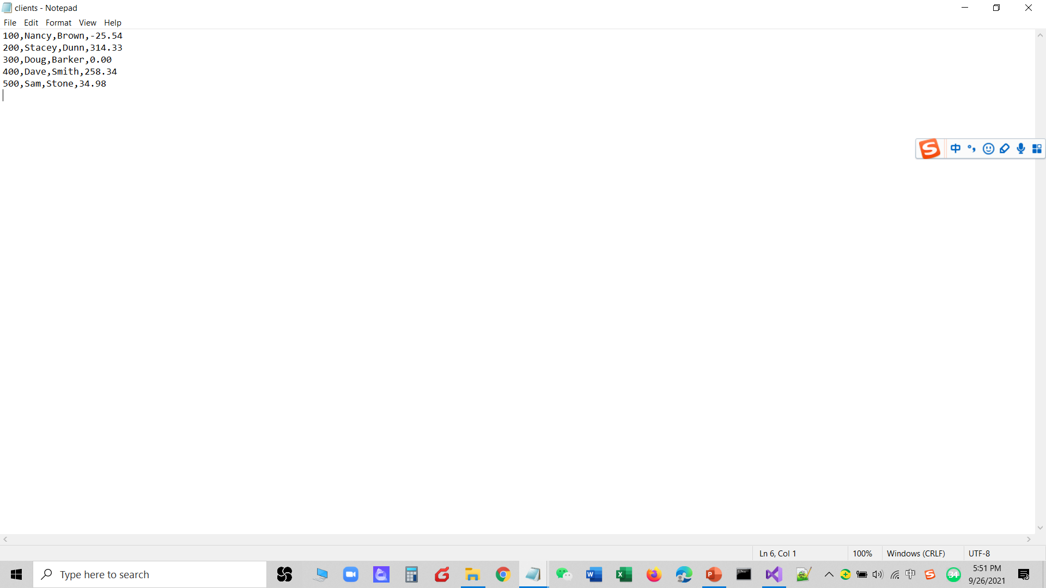

Slide 50
17.4 Reading Data from a Sequential-Access Text File
Class ReadSequentialAccessFileForm (Fig. 17.6) reads records from the file created by the program in Fig. 17.4, then displays the contents of each record.
Much of the code in this example is similar to that of Fig. 17.4, so we discuss only the unique aspects of the app.

Slide 51
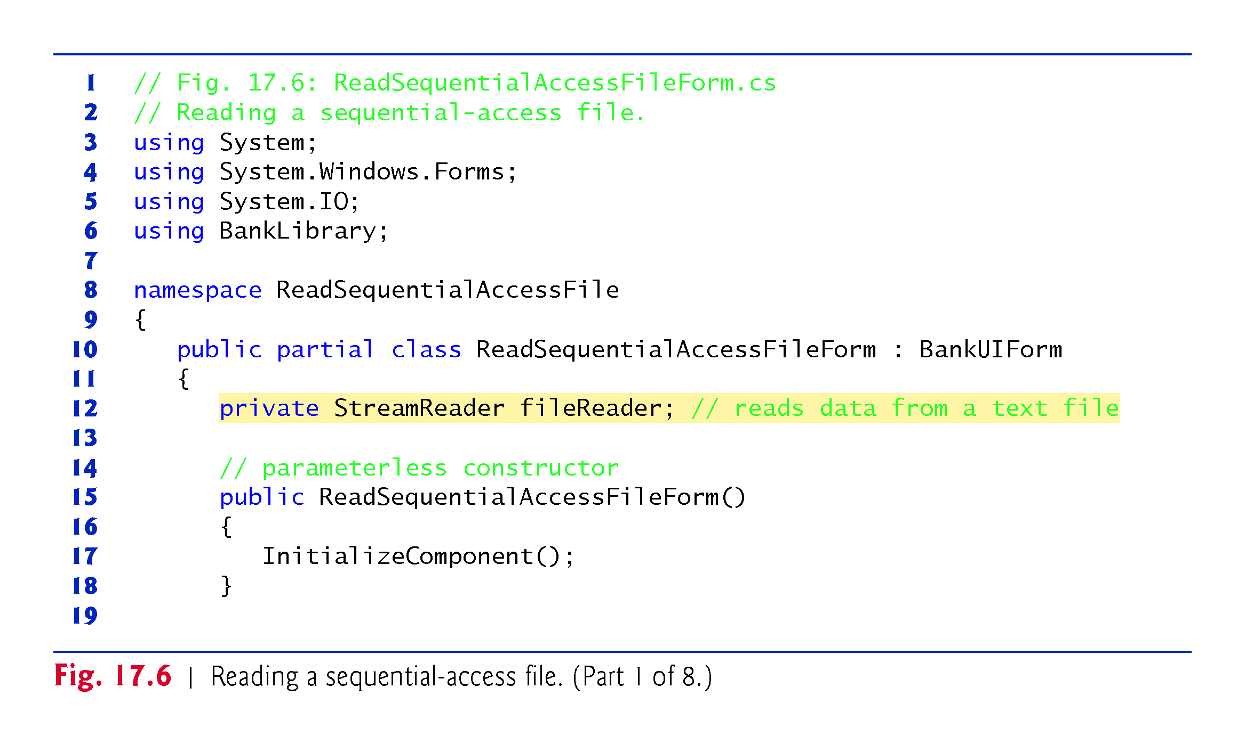

Slide 52
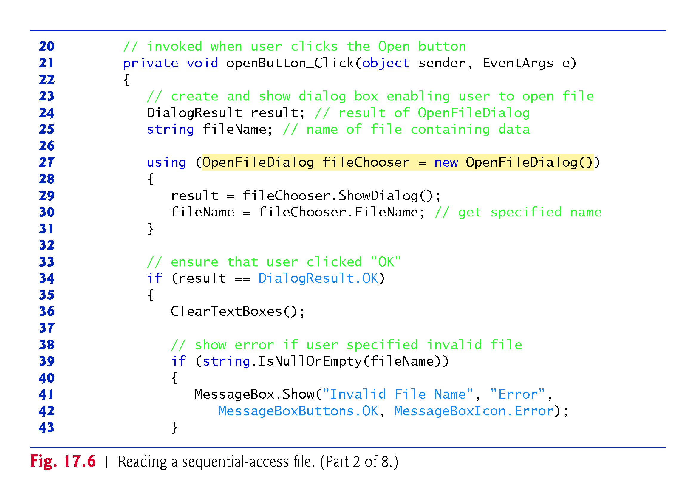
??

Slide 53
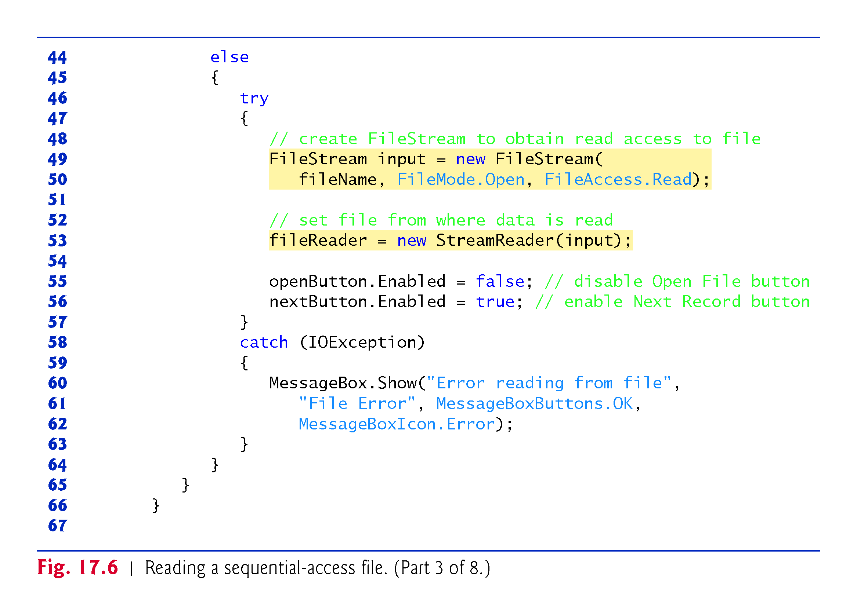

Slide 54
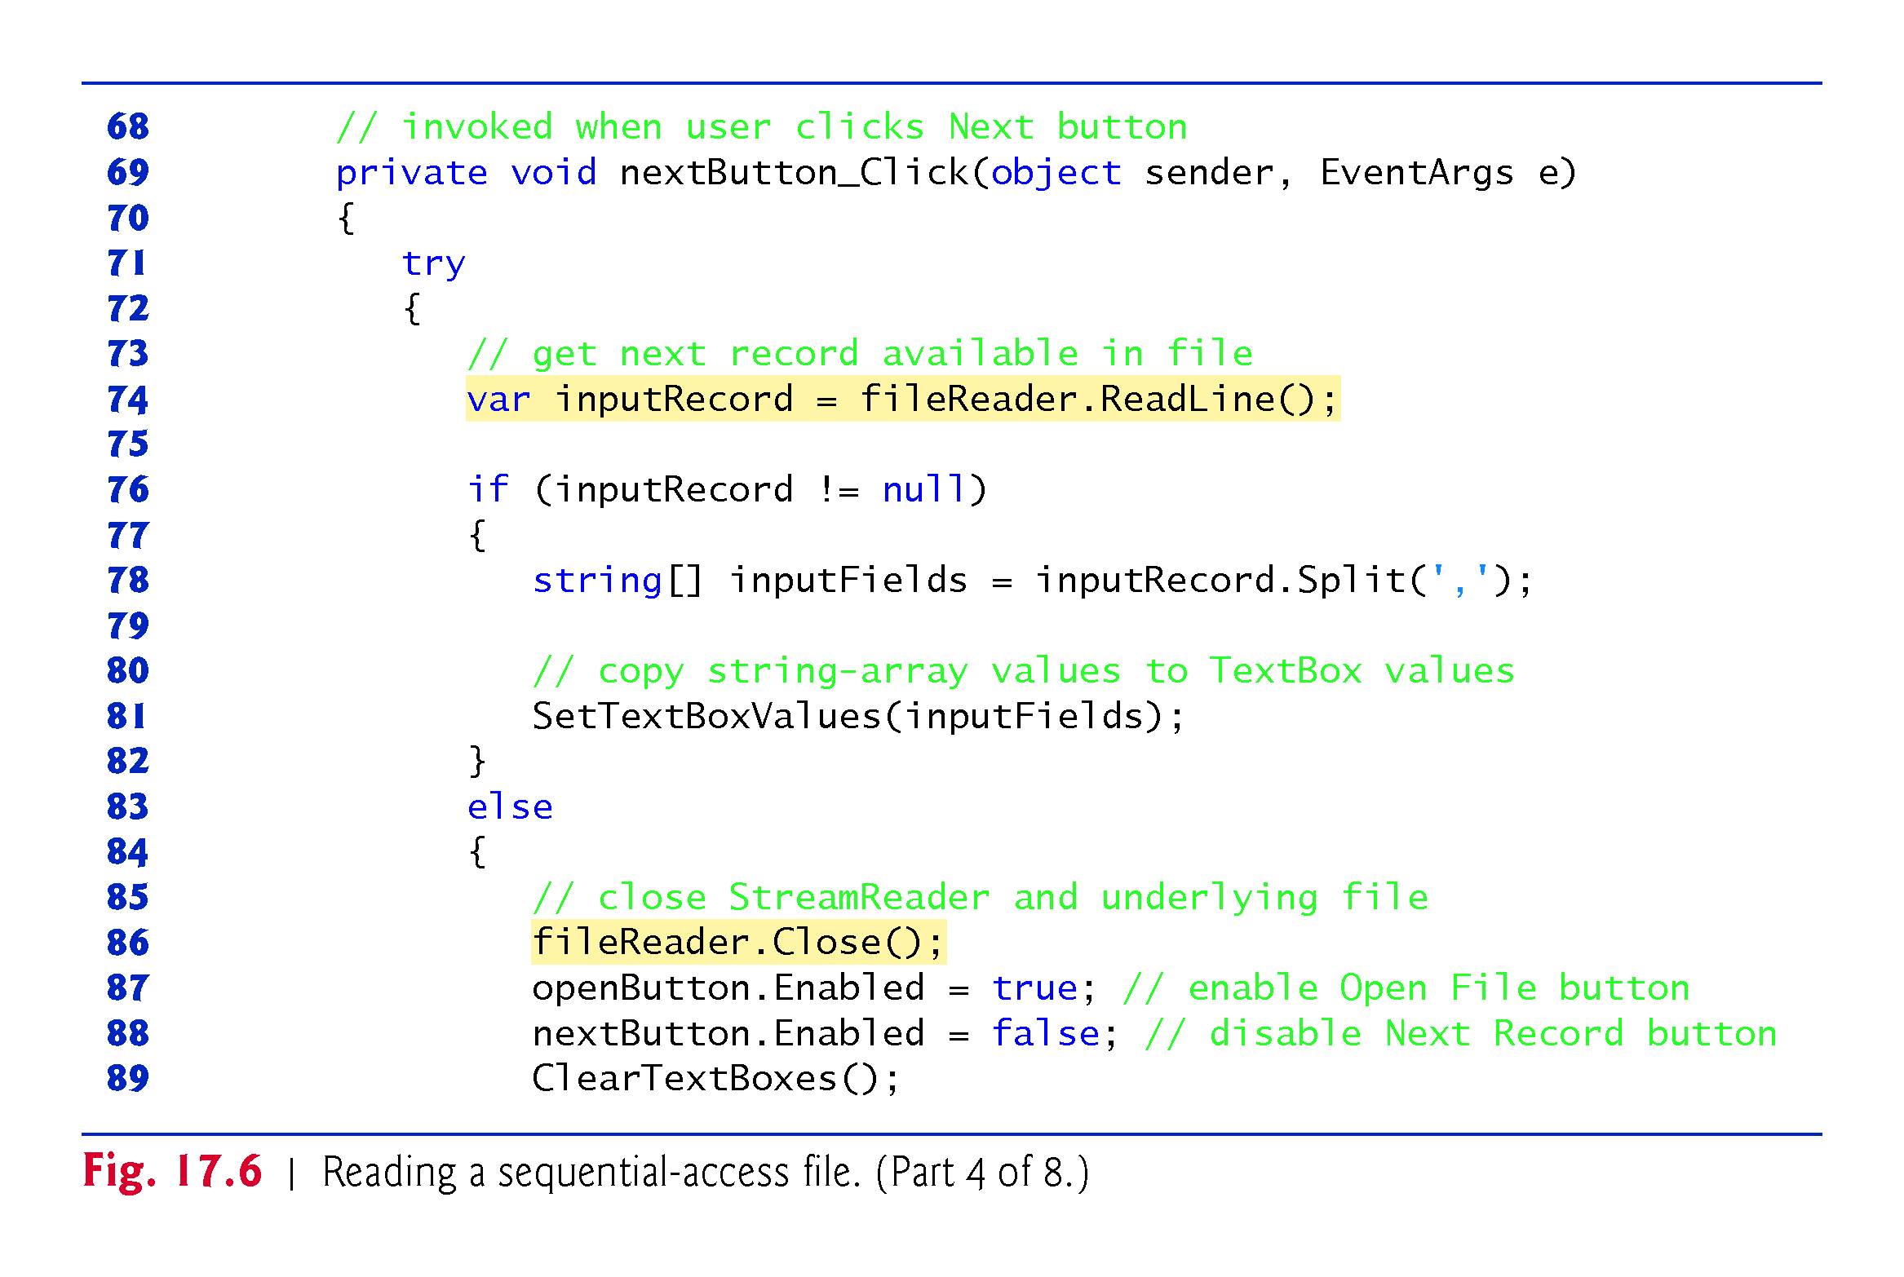

Slide 55
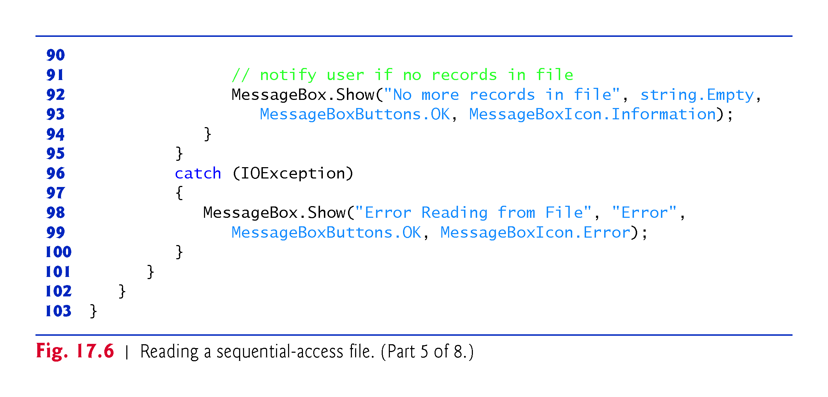

Slide 56
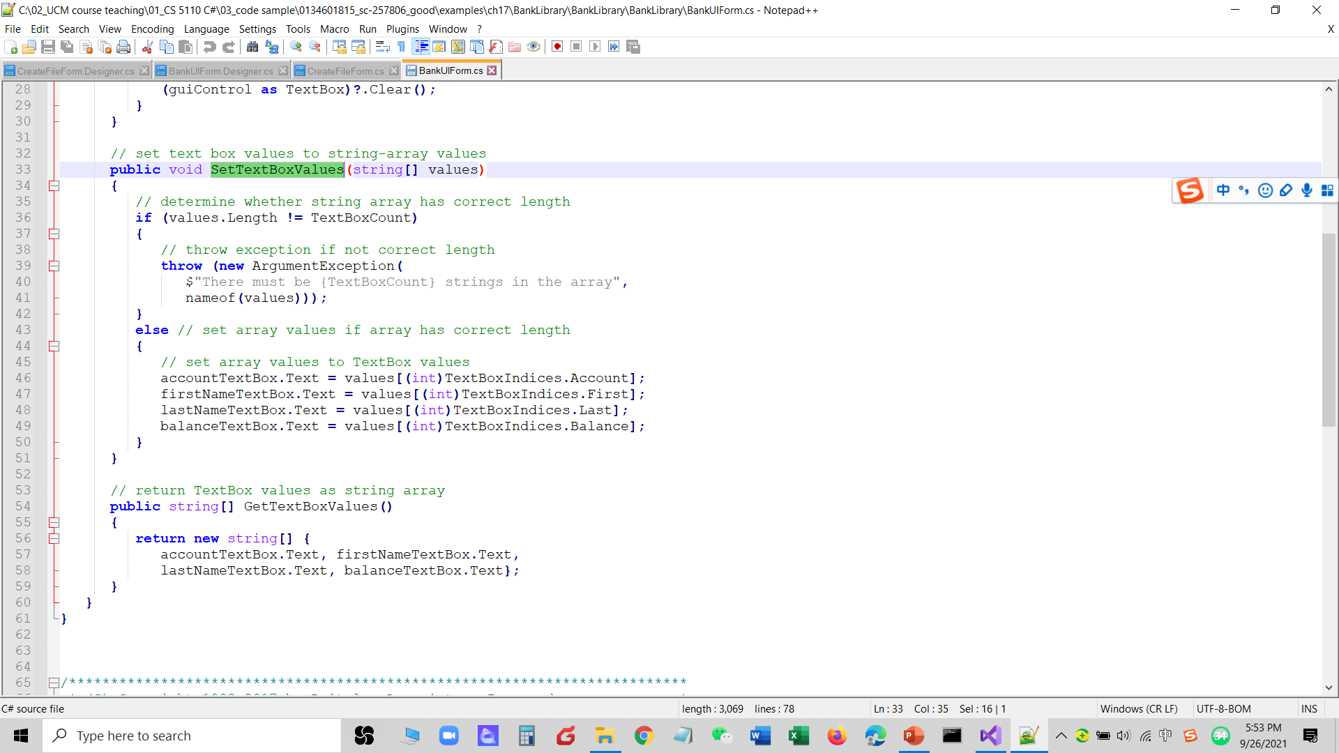

Slide 57
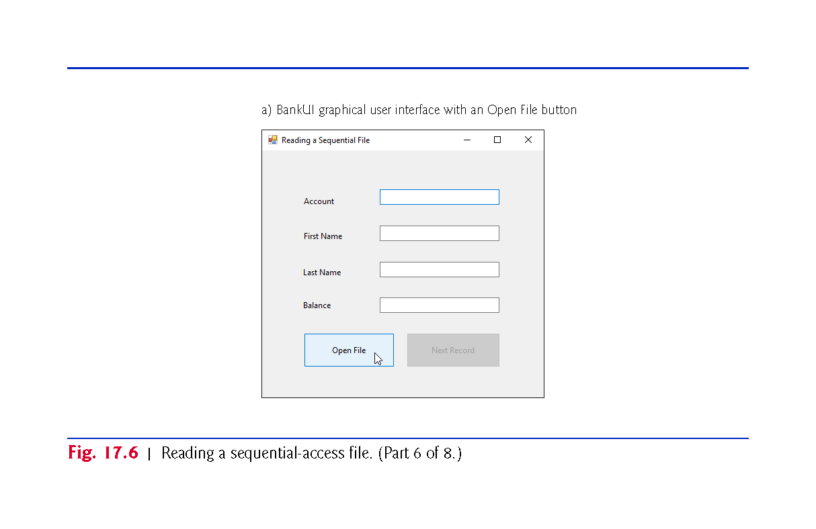

Slide 58
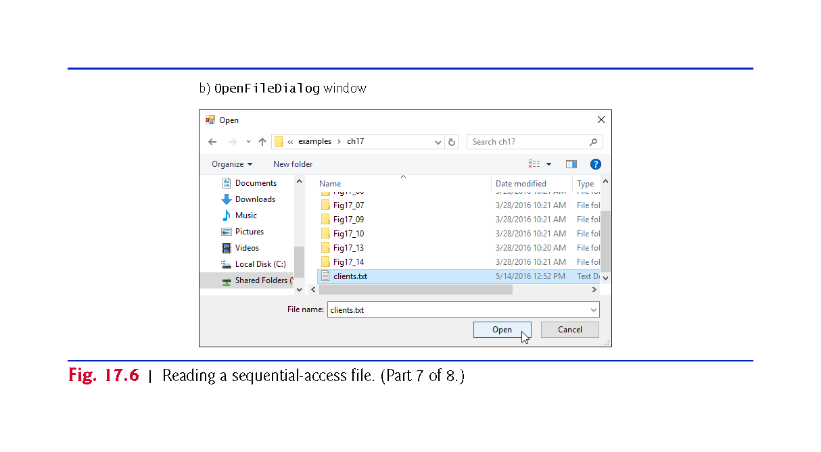

Slide 59
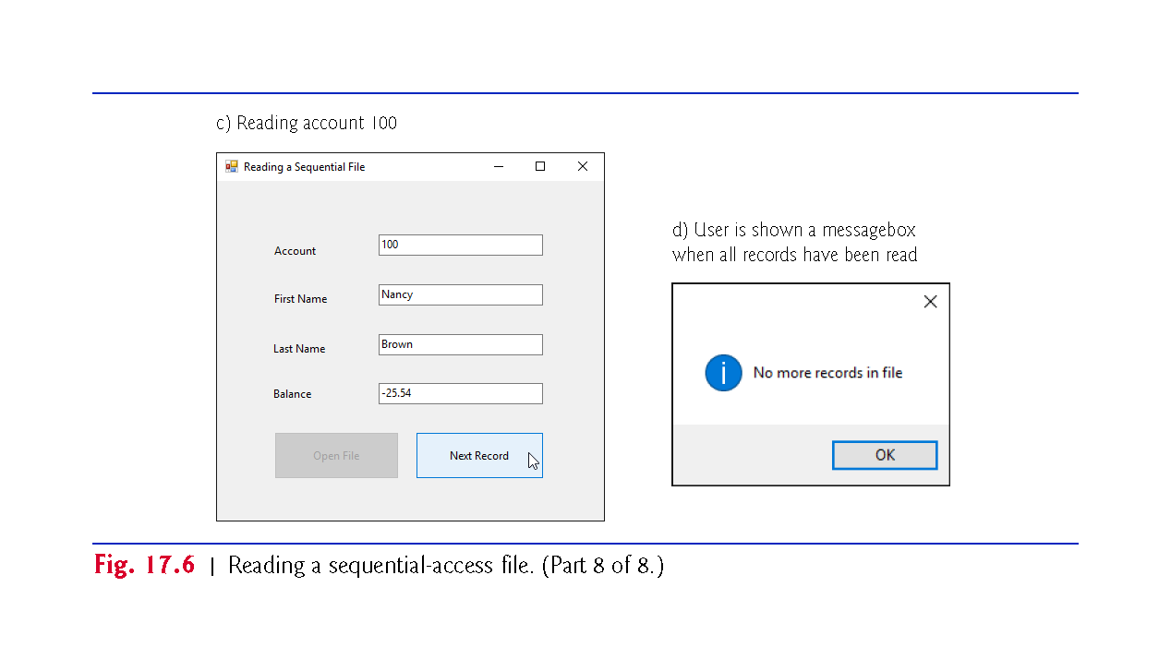

Slide 60
17.4 Reading Data from a Sequential-Access Text File (cont.)
Method openButton_Click
When the user clicks Open File, the program calls event handler openButton_Click.
Line 27 creates an OpenFileDialog, and line 29 calls its ShowDialog method to display the Open dialog.
The behavior and GUI for the Save and Open dialog types are identical, except that Save is replaced by Open.
If the user selects a valid file name, lines 49–50 create a FileStream object and assign it to reference input.

Slide 61
17.4 Reading Data from a Sequential-Access Text File (cont.)
We pass constant FileMode.Open as the second argument to the FileStream constructor to indicate that the FileStream should open the file if it exists or throw a FileNotFoundException if it does not. (In this example, the FileStream constructor will not throw a FileNotFoundException, because the OpenFileDialog is configured to check that the file exists.)
In the last example (Fig. 17.9), we wrote text to the file using a FileStream object with write-only access.

Slide 62
17.4 Reading Data from a Sequential-Access Text File (cont.)
In this example, we specify read-only access to the file by passing constant FileAccess.Read as the third argument to the FileStream constructor.
This FileStream object is used to create a StreamReader object.
The FileStream object specifies the file from which the StreamReader object will read text.

Slide 63
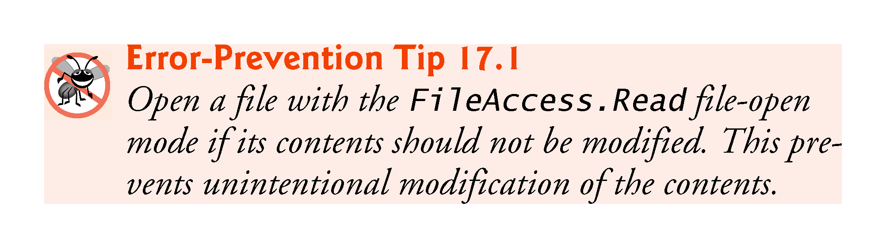

Slide 64
17.4 Reading Data from a Sequential-Access Text File (cont.)
Method nextButton_Click
When the user clicks the Next Record button, the program calls event handler nextButton_Click, which reads the next record from the user-specified file.
The user must click Next Record after opening the file to view the first record.
Line 74 calls StreamReader method ReadLine to read the next record.
If an error occurs while reading the file, an IOException is thrown and the user is notified.

Slide 65
17.4 Reading Data from a Sequential-Access Text File (cont.)
Otherwise, line 76 determines whether StreamReader method ReadLine returned null (i.e., there’s no more text in the file).
If not, method Split of class string separates the stream of characters that was read from the file into tokens (strings) that represent the Record’s properties—the second argument indicates that the tokens are delimited by commas in this file.
If ReadLine returns null, the program closes the StreamReader object, automatically closing the FileStream object, then notifies the user that there are no more records.

Slide 66
17.5 Case Study: Credit Inquiry Program
To retrieve data sequentially from a file, programs normally start from the beginning of the file, reading consecutively until the desired data is found.
It sometimes is necessary to process a file sequentially several times (from the beginning of the file) during the execution of a program.
A FileStream object can reposition its file-position pointer (which contains the byte number of the next byte to be read from or written to the file) to any position in the file.
When a FileStream object is opened, its file-position pointer is set to byte position 0 (i.e., the beginning of the file)

Slide 67
17.5 Case Study: Credit Inquiry Program (cont.)
Class CreditInquiryForm (Fig. 17.7) is a credit-inquiry program that enables a credit manager to search for and display account information for those customers with credit balances (i.e., customers to whom the company owes money), zero balances (i.e., customers who do not owe the company money) and debit balances (i.e., customers who owe the company money for previously received goods and services).

Slide 68
17.5 Case Study: Credit Inquiry Program (cont.)
We use a RichTextBox in the program to display the account information.
RichTextBoxes provide more functionality than regular TextBoxes
for example, RichTextBoxes offer method Find for searching individual strings and method LoadFile for displaying file contents.
Classes RichTextBox and TextBox both inherit from abstract class System.Windows.Forms.TextBoxBase.
In this example, we chose a RichTextBox, because it displays multiple lines of text by default, whereas a regular TextBox displays only one.
We could have specified that a TextBox object display multiple lines of text by setting its Multiline property to true.

Slide 69
17.5 Case Study: Credit Inquiry Program (cont.) demo
The program displays buttons that enable a credit manager to obtain credit information.
The Open File button opens a file for gathering data.
The Credit Balances button displays a list of accounts that have credit balances, the Debit Balances button displays a list of accounts that have debit balances and the Zero Balances button displays a list of accounts that have zero balances.
The Done button exits the app.

Slide 70
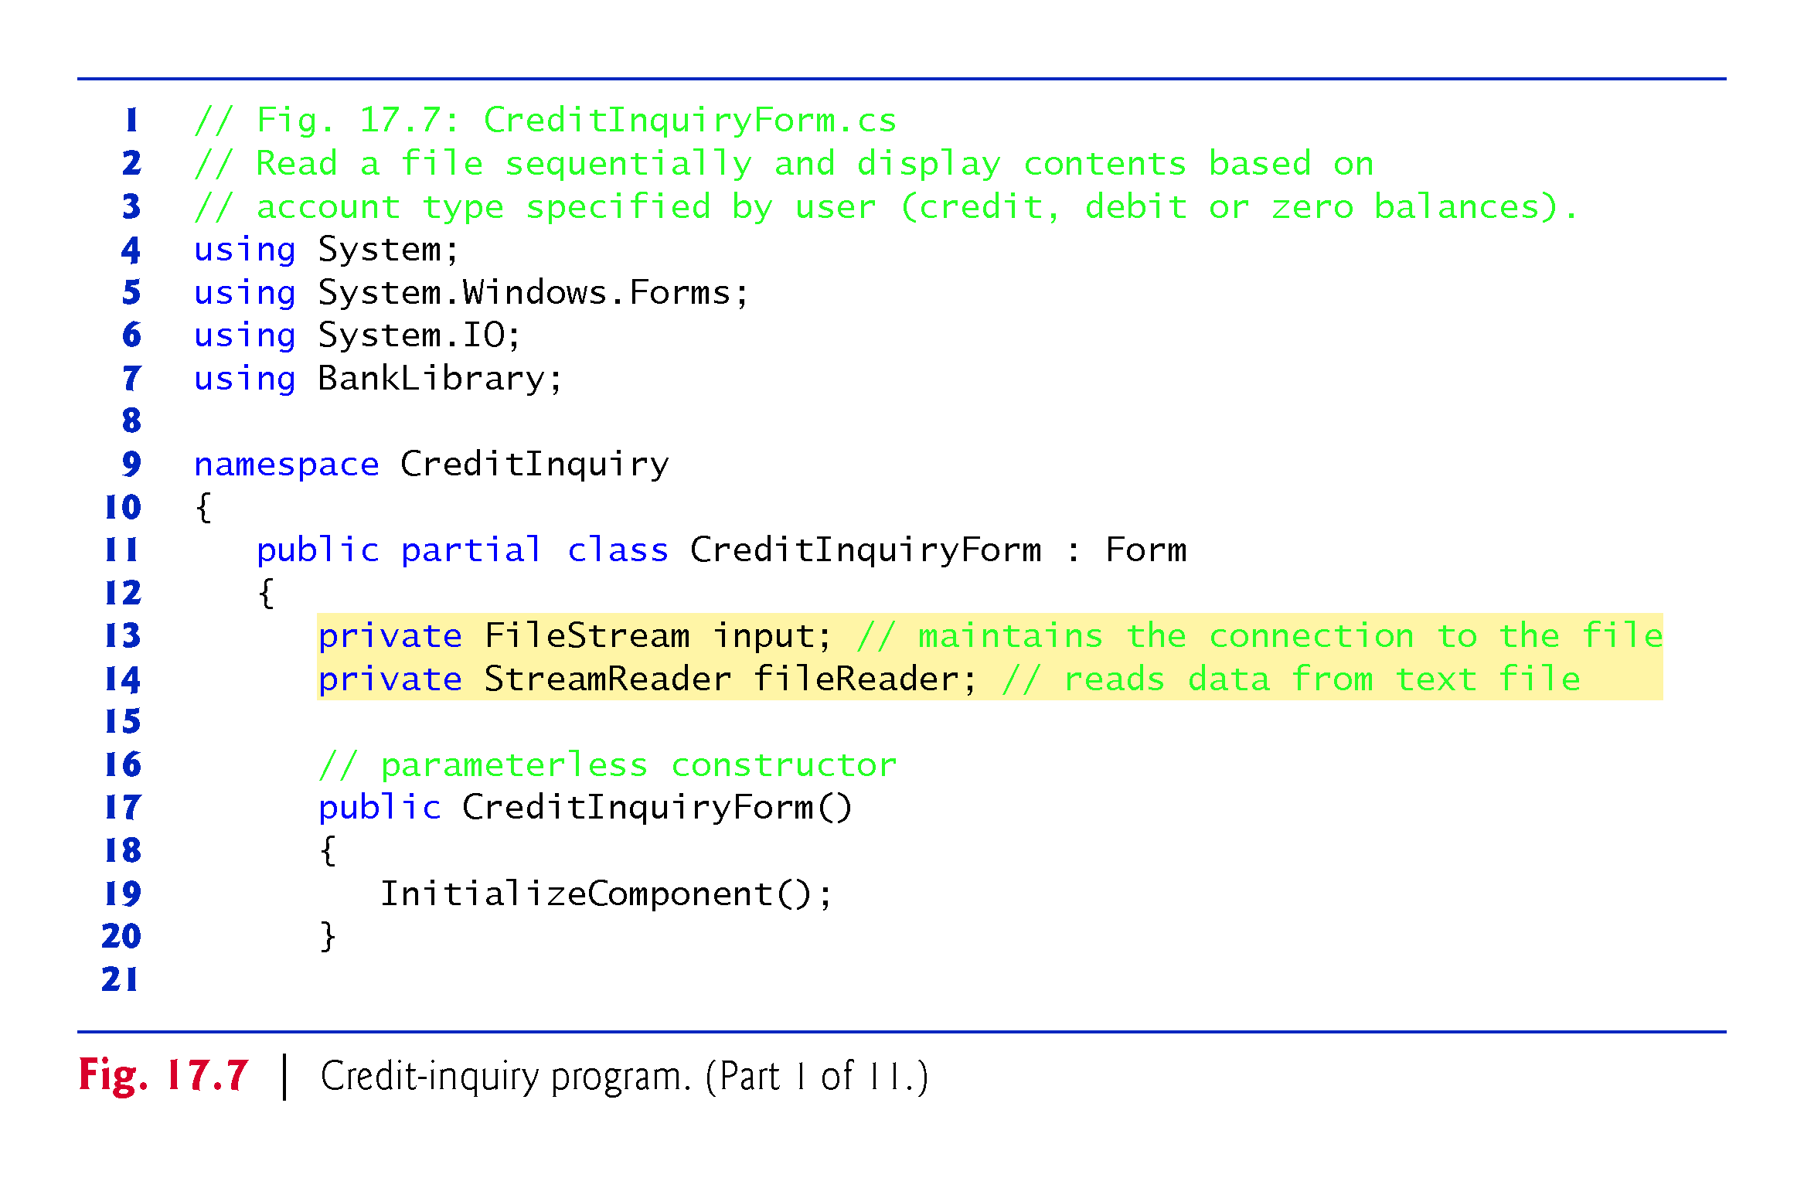

Slide 71
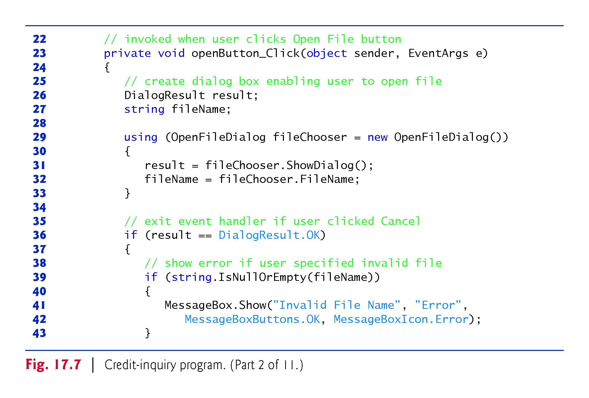

Slide 72
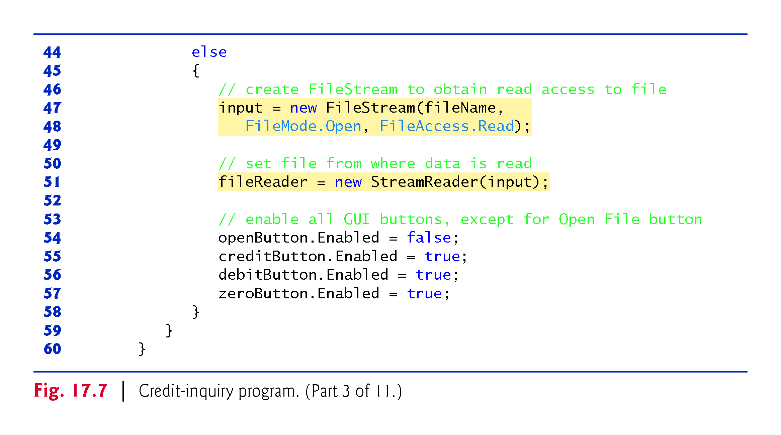

Slide 73
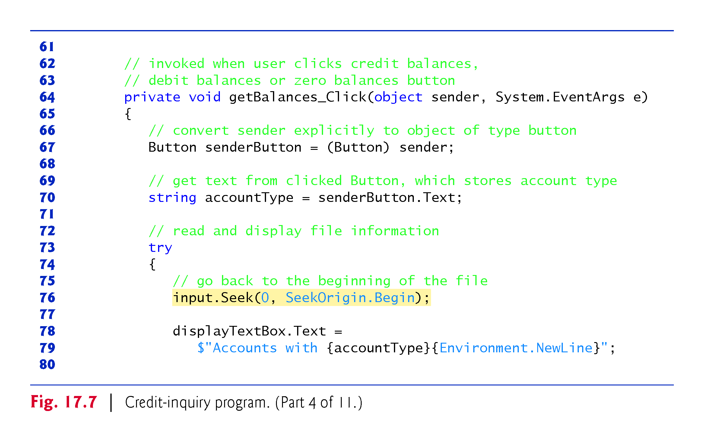
??
One handler handles 3 button

Slide 74
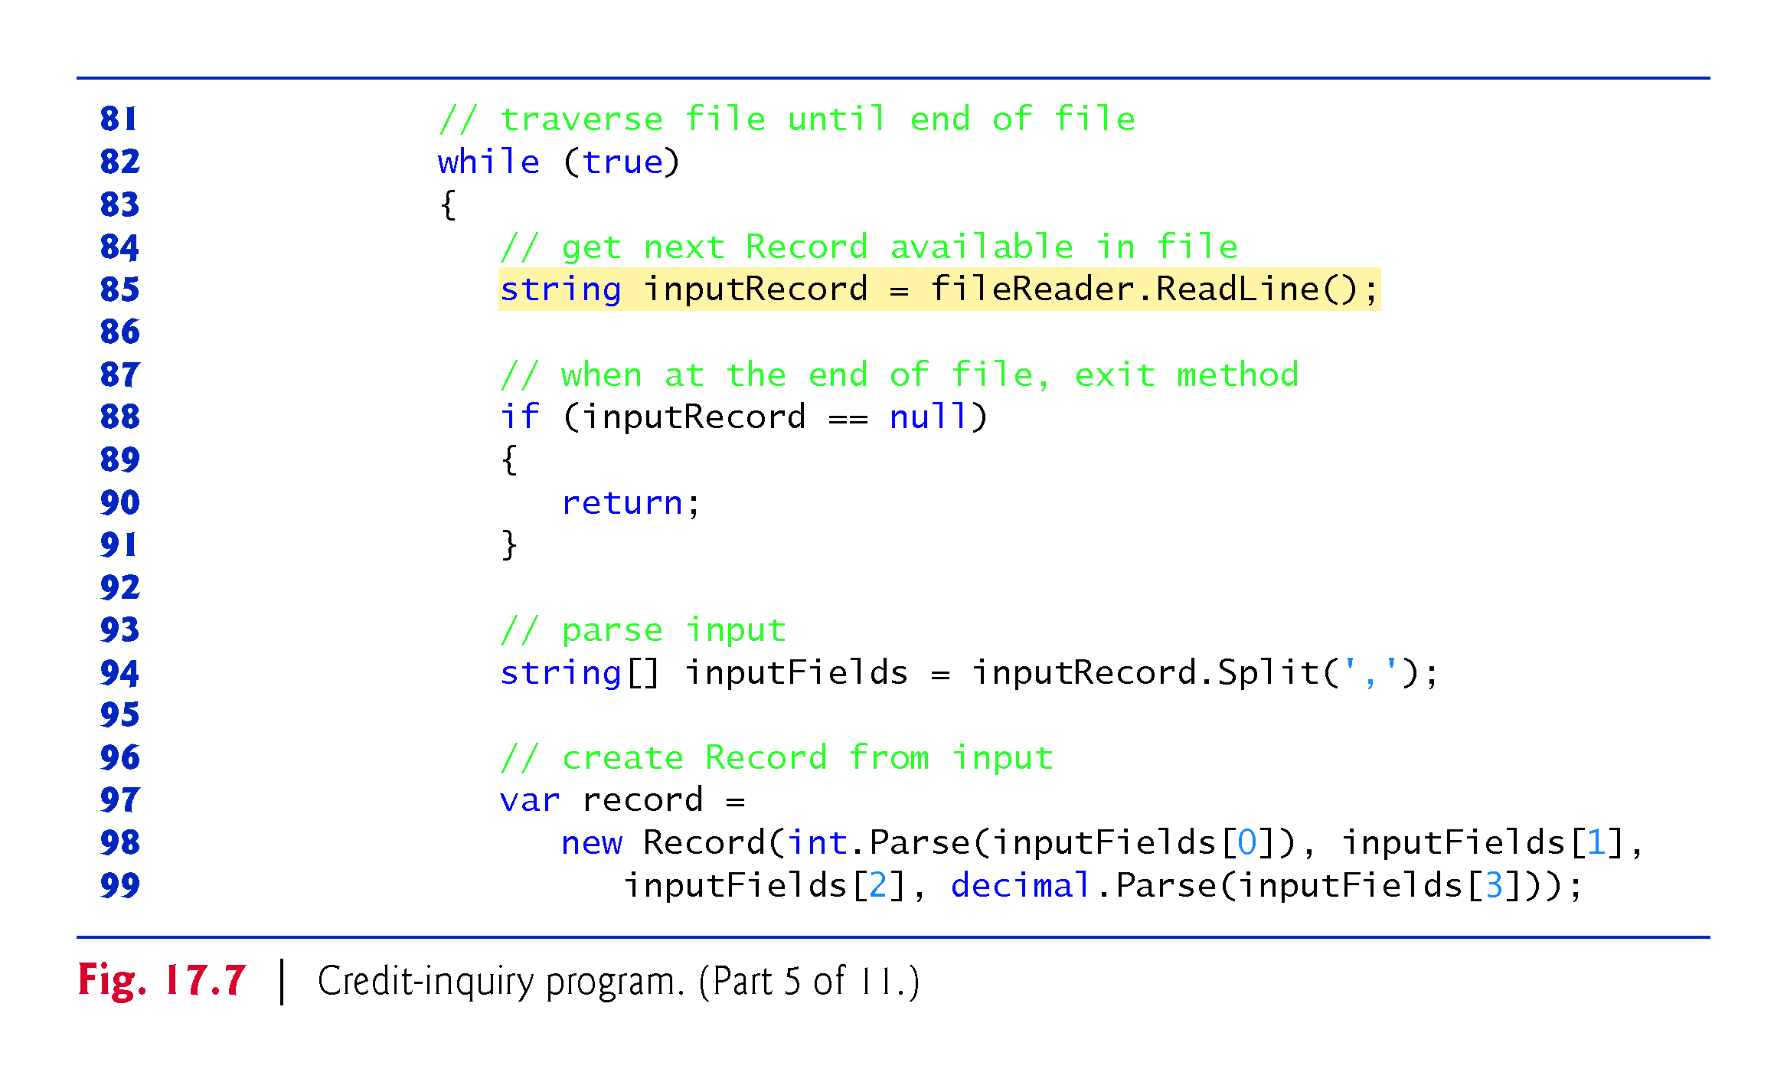

Slide 75
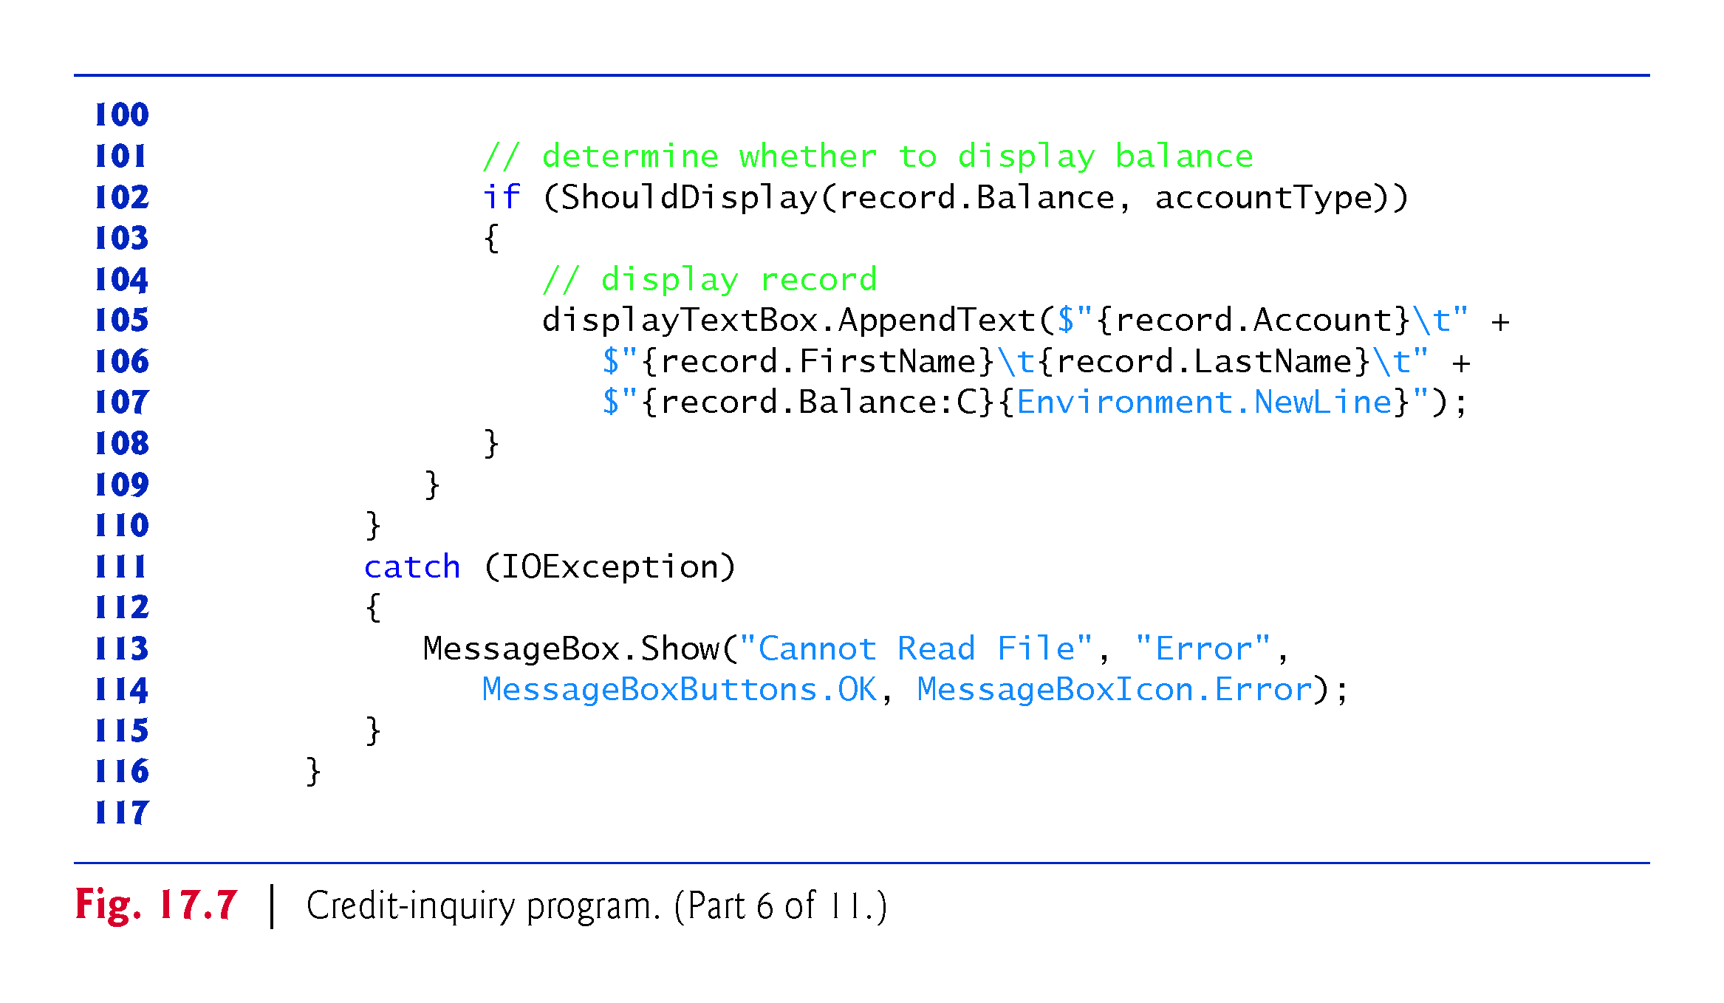

Slide 76
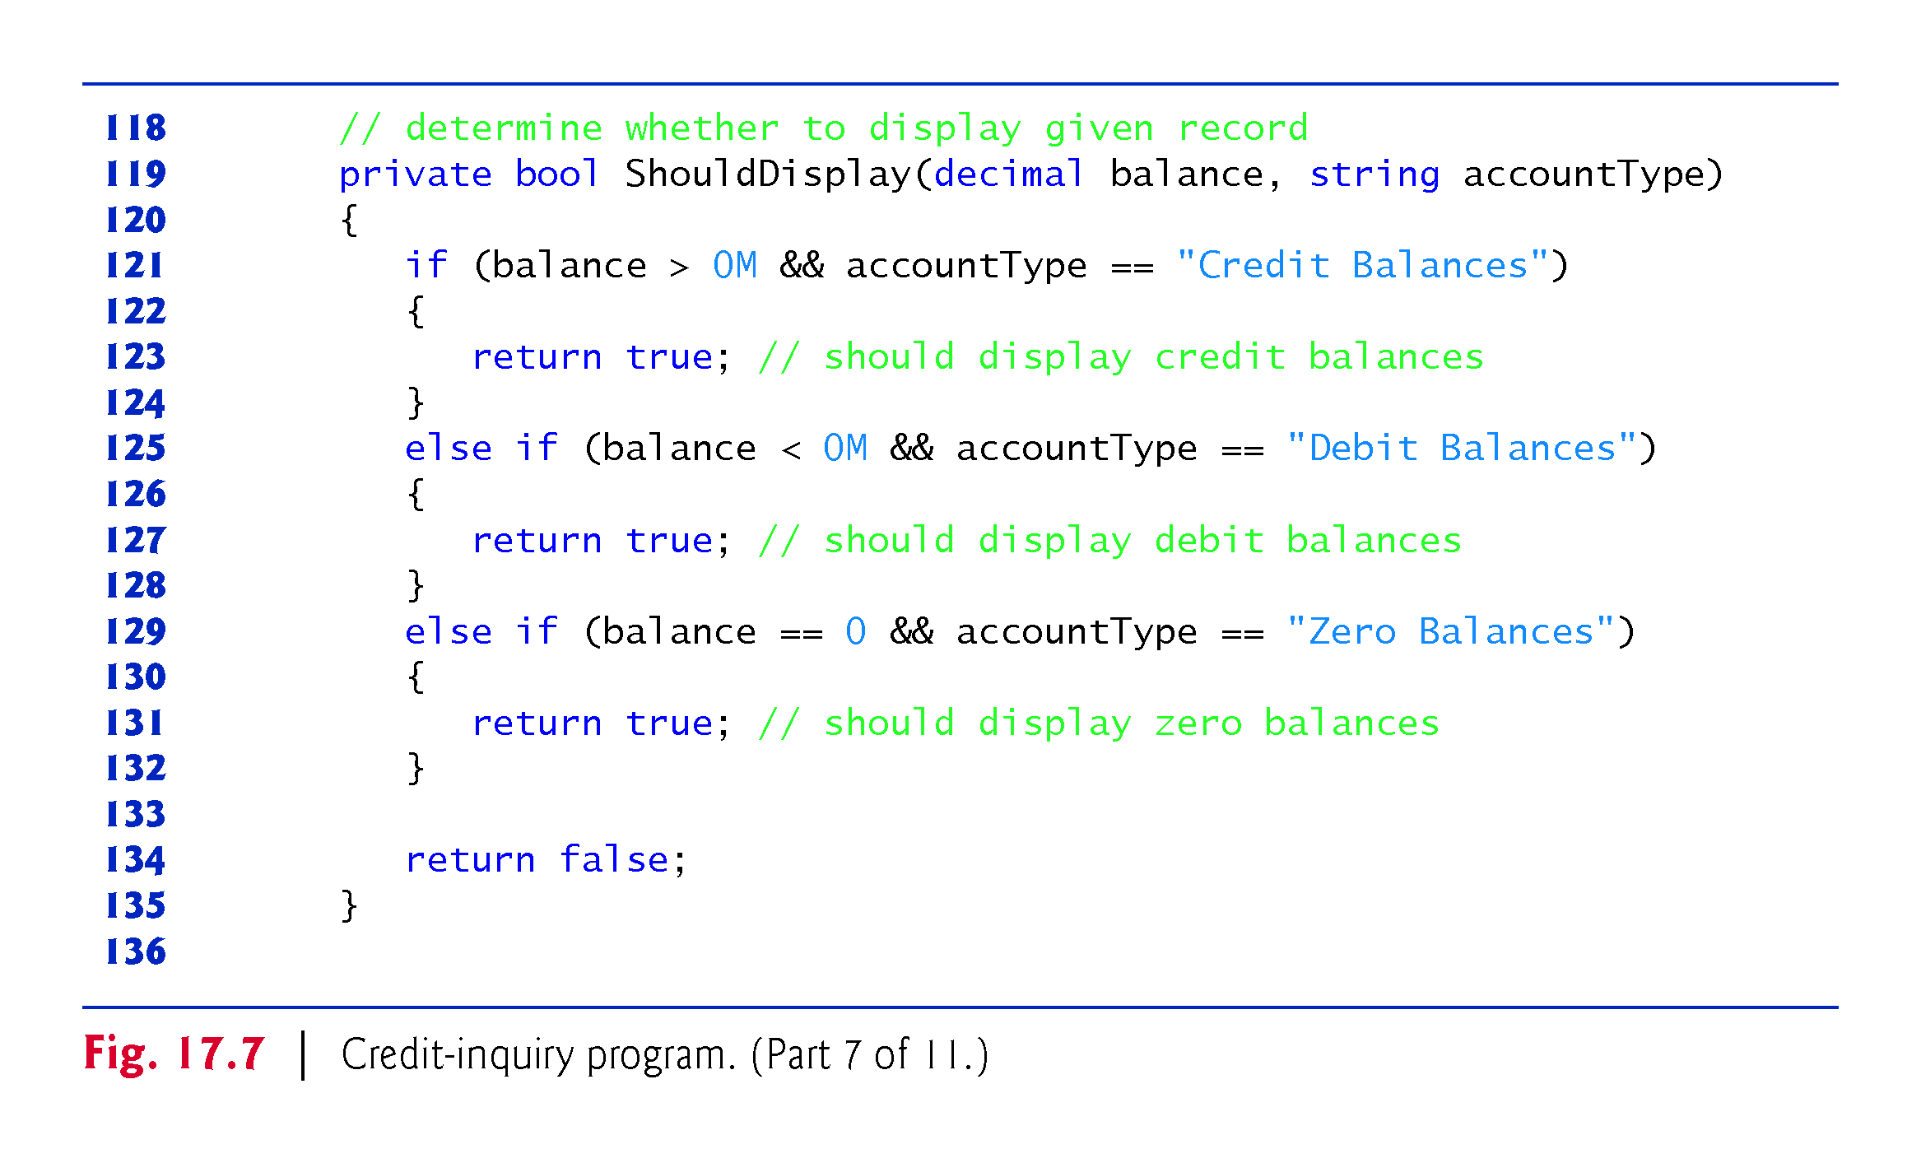

Slide 77
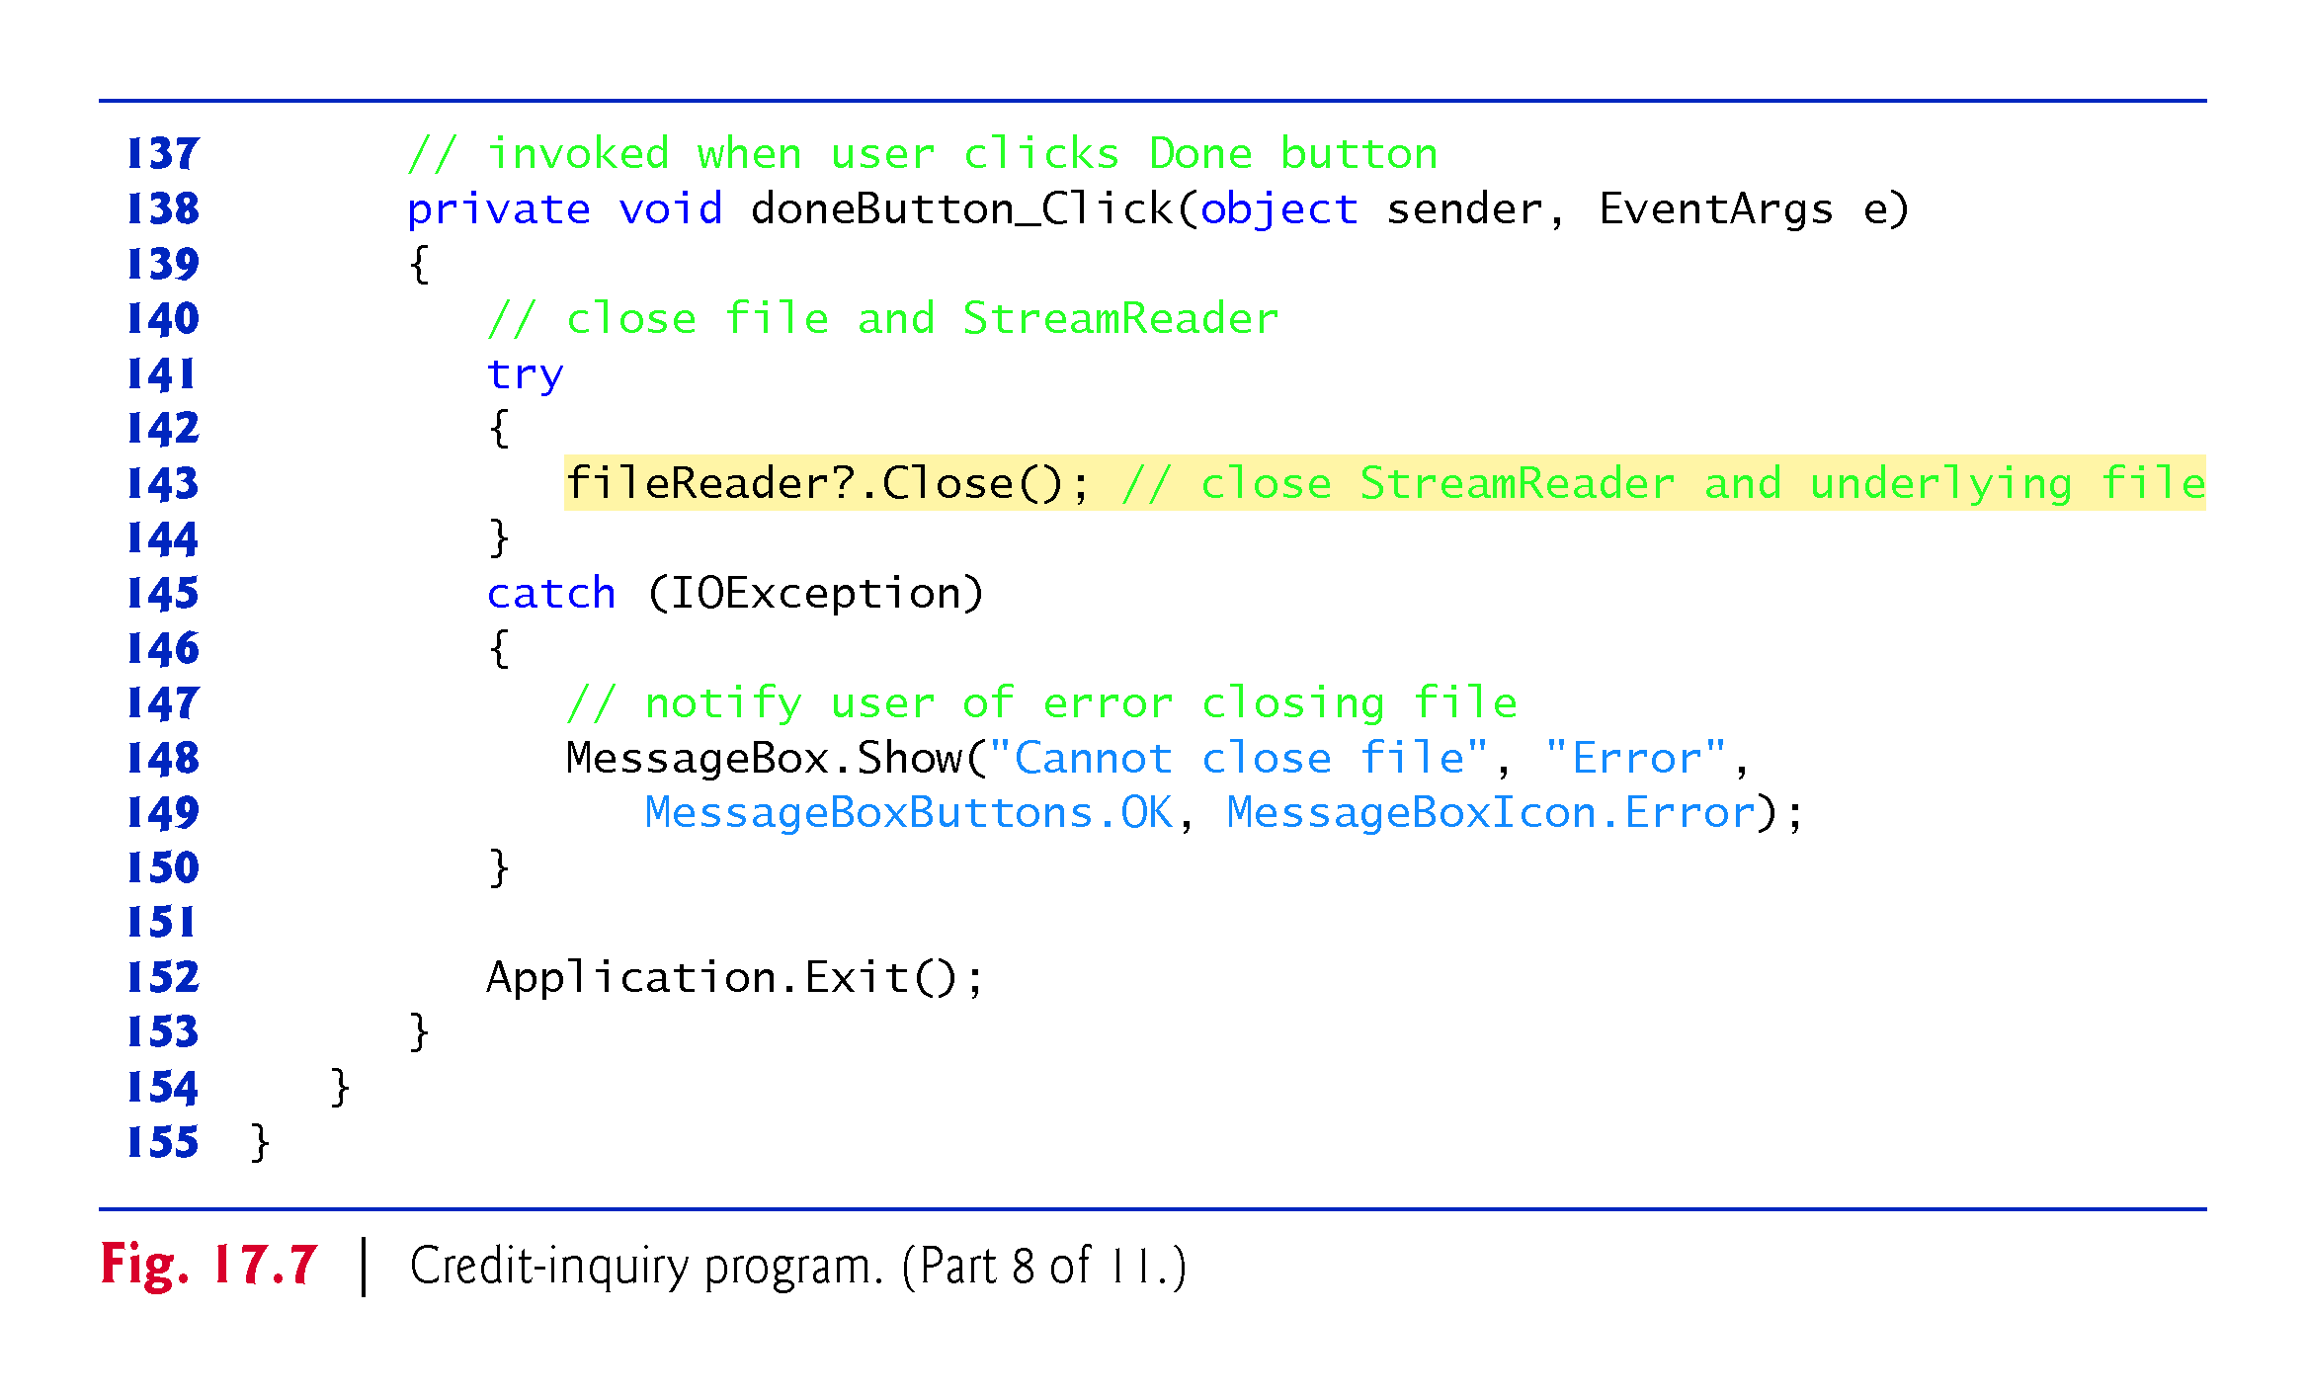
??

Slide 78


Slide 79


Slide 80


Slide 81


Slide 82


Slide 83


Slide 84


Slide 85
17.6 Serialization
Record class
Only serialized Object can be written to file: otherwise data format is lost
serialized object written to file: data(encapsulated) format is kept
Read a serialized object from file and deserialized the object and data format is kept
!!!

Slide 86
Serialization
https://hazelcast.com/glossary/serialization/
Serialization is the process of converting a data object—a combination of code and data represented within a region of data storage—into a series of bytes that saves the state of the object in an easily transmittable form.
In this serialized form, the data can be delivered to another data store (such as an in-memory computing platform), application, or some other destination.
Data serialization is the process of converting an object into a stream of bytes to more easily save or transmit it.
!!!
!!!

Slide 87


Slide 88
deserialization
The reverse process—constructing a data structure or object from a series of bytes—is deserialization.
The deserialization process recreates the object, thus making the data easier to read and modify as a native structure in a programming language.
!!!
!!!

Slide 89


Slide 92
17.6 Serialization
In the prior examples, Record was used to aggregate the information for one record.
When the instance variables for a Record were output to a disk file, certain information was lost, such as the type of each value.
For instance, if the value "3" is read from a file, there’s no way to tell if the value came from an int, a string or a decimal.

Slide 93
17.6 Serialization (cont.)
We have only data, not type information, on disk.
If the program that’s going to read this data “knows” what object type the data corresponds to, then the data can be read directly into objects of that type.
For example, in Fig. 17.11, we know that we are inputting an int (the account number), the first and last name strings and a decimal (the balance).
We also know that these values are separated by commas, with only one record on each line.
So, we are able to parse the strings and convert the account number to an int and the balance to a decimal.

Slide 94
17.6 Serialization (cont.)
Sometimes it would be easier to read or write entire objects.
C# provides such a mechanism, called object serialization.
A serialized object is an object represented as a sequence of bytes that includes the object’s data, as well as information about the object’s type and the types of data stored in the object.
After a serialized object has been written to a file, it can be read from the file and deserialized—that is, the type information and bytes that represent the object and its data can be used to recreate the object in memory.

Slide 95
17.6 Serialization (cont.)
Class BinaryFormatter (namespace System.Runtime.Serialization.Formatters.Binary) enables entire objects to be written to or read from a stream.
BinaryFormatter method Serialize writes an object’s representation to a file.
BinaryFormatter method Deserialize reads this representation from a file and reconstructs the original object.
Both methods throw a SerializationException if an error occurs during serialization or deserialization.
Both methods require a Stream object (e.g., the FileStream) as a parameter so that the BinaryFormatter can access the correct stream.

Slide 96
17.6 Serialization (cont.)
Next, we create and manipulate sequential-access files using object serialization.
Object serialization is performed with byte-based streams, so the sequential files created and manipulated will be binary files.
Binary files are not human readable.
For this reason, we write a separate app that reads and displays serialized objects.

Slide 97
17.7 Creating a Sequential-Access File Using Object Serialization
We begin by creating and writing serialized objects to a sequential-access file.
In this section, we reuse much of the code from earlier sections, so we focus only on the new features.

Slide 98
17.7 Creating a Sequential-Access File Using Object Serialization (cont.)
Defining the RecordSerializable Class
Class RecordSerializable (Fig. 17.8; part of the BankLibrary project) is marked with the [Serializable] attribute (line 7), which indicates to the CLR that RecordSerializable objects can be serialized.
Classes that represent serializable types must include this attribute in their declarations or must implement interface ISerializable.

Slide 99


Slide 100


Slide 101
17.7 Creating a Sequential-Access File Using Object Serialization (cont.)
In a class that’s marked with the [Serializable] attribute or that implements interface ISerializable, you must ensure that every instance variable of the class is also serializable.
All simple-type variables and strings are serializable.
For variables of reference types, you must check the class declaration (and possibly its base classes) to ensure that the type is serializable.
By default, array objects are serializable.
However, if the array contains references to other objects, those objects may or may not be serializable.

Slide 102
17.7 Creating a Sequential-Access File Using Object Serialization (cont.)
Using a Serialization Stream to Create an Output File
Next, we’ll create a sequential-access file with serialization (Fig. 17.9).
To test this program, we used the sample data from Fig. 17.5 to create a file named clients.ser.
Line 15 creates a BinaryFormatter for writing serialized objects.
Lines 55–56 open the FileStream to which this program writes the serialized objects.
The string argument that’s passed to the FileStream’s constructor represents the name and path of the file to be opened.
This specifies the file to which the serialized objects will be written.

Slide 103
17.7 Creating a Sequential-Access File Using Object Serialization (cont.)
The program does not show how the data records actually appear in the file.
Remember that we are now using binary files, which are not human readable.
To verify that the file was created successfully, the next section presents a program to read the file’s contents.

Slide 104


Slide 105


Slide 106


Slide 107


Slide 108


Slide 109


Slide 110


Slide 111
17.8 Reading and Deserializing Data from a Binary File
The preceding section showed how to create a sequential-access file using object serialization.
In this section, we discuss how to read serialized objects sequentially from a file.
Figure 17.10 reads and displays the contents of the clients.ser file created by the program in Fig. 17.9.

Slide 112
17.8 Reading and Deserializing Data from a Binary File (cont.)
The program reads objects from a file in event handler nextButton_Click.
We use method Deserialize to read the data.
Note that we cast the result of Deserialize to type RecordSerializable—this cast is necessary, because Deserialize returns a reference of type object and we need to access properties that belong to class RecordSerializable.
If an error occurs during deserialization or the end of the file is reached, a SerializationException is thrown, and the FileStream object is closed.

Slide 113


Slide 114


Slide 115


Slide 116


Slide 117

??

Slide 118
17.9 Classes File and Directory
Information is stored in files, which are organized in directories (also called folders).
Classes File and Directory enable programs to manipulate files and directories on disk.
Class File can determine information about files and can be used to open files for reading or writing.
Figure 17.11 lists several of class File’s static methods for manipulating and determining information about files.

Slide 119


Slide 120


Slide 121
17.9 Classes File and Directory (cont.)
Class Directory provides capabilities for manipulating directories.
Figure 17.12 lists some of class Directory’s static methods for directory manipulation.
The DirectoryInfo object returned by method CreateDirectory contains information about a directory.
Much of the information contained in class DirectoryInfo also can be accessed via the methods of class Directory.

Slide 122


Slide 123


Slide 124
17.9 Classes File and Directory (cont.)
Demonstrating Classes File and Directory
Class FileTestForm (Fig. 17.13) uses File and Directory methods to access file and directory information.

Slide 125


Slide 126


Slide 127


Slide 128


Slide 129


Slide 130


Slide 131


Slide 132


Slide 133
17.9 Classes File and Directory (cont.)??
Searching Directories with LINQ
We now consider another example that uses file- and directory-manipulation capabilities.
Class LINQToFileDirectoryForm (Fig. 17.14) uses LINQ with classes File, Path and Directory to report the number of files of each file type that exist in the specified directory path.

Slide 134
17.9 Classes File and Directory (cont.)
The program also serves as a “clean-up” utility—when it finds a file that has the .bak file-name extension (i.e., a backup file), the program displays a MessageBox asking the user whether that file should be removed, then responds appropriately to the user’s input.
This example also uses LINQ to Objects to help delete the backup files.

Slide 135

Notes:
https://docs.microsoft.com/en-us/dotnet/api/system.collections.generic.dictionary-2?view=net-5.0
Dictionary<TKey,TValue> Class
Represents a collection of keys and values.

Slide 136


Slide 137


Slide 138


Slide 139


Slide 140


Slide 141


Slide 142


Slide 143

If not .bak file found,
add a .bak file.

Slide 144


Slide 145


